Slide 1
Chapter 38
Shadow of War

Slide 2
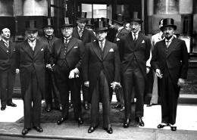
London Conference
Met in 1933
FDR criticized the conference
Did not want to commit to a currency plan that would limit his freedom
By denouncing, more isolationism and nationalism
Played into hands of dictators

Slide 3
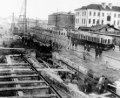
Recognizing Russia
1933
Might encourage Russia to stand up to Japanese
Possible trade and profits develop
Why else:
He was an outspoken liberal, not bound by the conservatives of his Republican predecessors: Bailey
Russia promised to stop propaganda in US but broke
Trade did not develop we did not loan money to SU because we considered her a poor credit risk

Slide 4
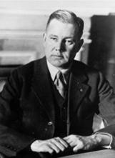
Philippines
Why push for freedom?
Depression
Want low wage Philippines excluded from US
Sugar producers want competition gone
Tydings McDuffie: 12 years we would let be free, give up military, but not naval bases

Slide 5
Good Neighborism
Armed intervention not been doing real well for us
Less investments to protect
Cooperation in W. Hemis
Seventh Pan American Conference
US renounced Platt, nonintervention
Last marines left Haiti in 34
Yankee oil in Mex seized prop, we did not go after
Made FDR look good, eagle not vulture

Slide 6
Hull’s Reciprocal Trade
Sec of State Cordell Hull
1934
Lower tariff by 50% without senate approval if other country will lower theirs
Trade increased 4x with LA countries
Reversed High Tariff policies since Civil War

Slide 7
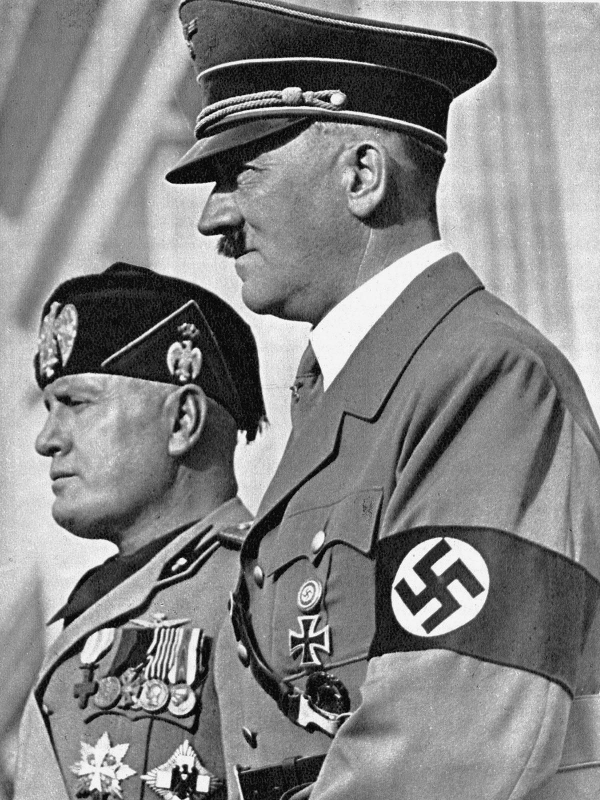
Storm Cellar Isolationism
Totalitarian states on rise in Europe
Stalin, Mussolini, and Hitler
Hitler most dangerous
Far East problems: Japan breaks Washington Conference agreement
Mussolini attacks Ethiopia
Isolationism: boost in America
Johnson Debt default act
Debt dodgers not allowed more money, may have hurt us
1936 VFW: Future

Slide 8
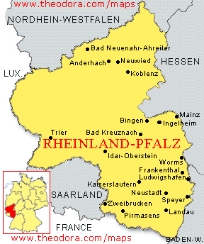
Hitler
Seized power in 33
Draft in 35
Rhineland 36
Sudetenland 38
Austria 38
Czech and Poland 39

Slide 9
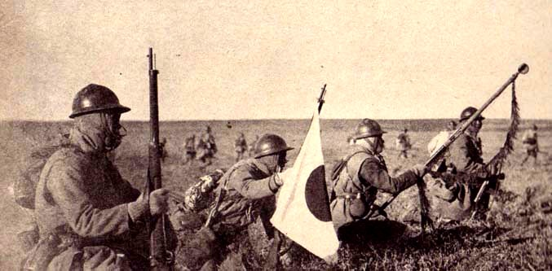
Japan
31 invades Manchuria
Renounce Washington Treaty of 22
Invade China 37

Slide 10
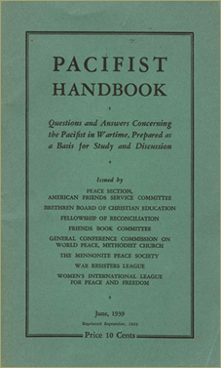
US Reaction
Hid our heads in sand
Thought protected by ocean
Pacifist movement result of All Quiet on the Western Front

Slide 11
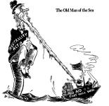
Neutrality
Nye Committee
Appointed in 34 to investigate weapons
Said bankers and weapons producers were to fault for WWI
Neutrality acts passed 35,36,37
Americans forbidden to sail on the ships of belligerent nations
Americans not sell or transport weapons to belligerent nations
Americans could not make loans to belligerent nations
Belligerent nations could purchase non military goods but only on a cash and carry basis

Slide 12
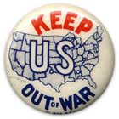
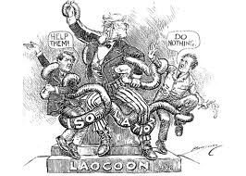
Results and the folly
The acts applied to both the aggressor and the victim
Indicated that we were abandoning our support of the freedom of the seas
we were no longer willing to fight and uphold our historic policies
Acts encourage dictators by telling them that their victims could expect no aid from U S

Slide 13
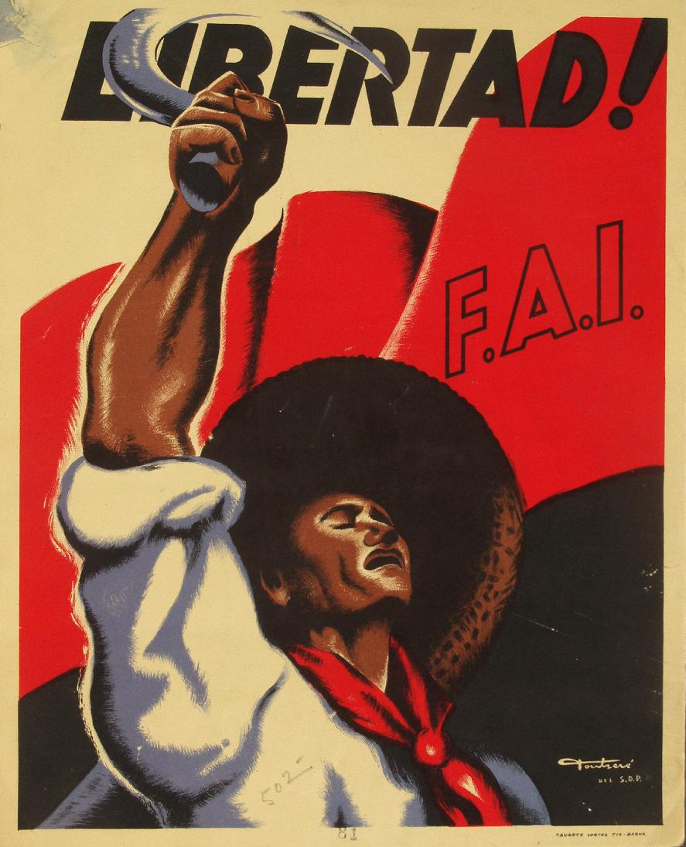
America dooms Spain
Civil War in Spain was an example of how we applied the neutrality laws and refused to aid the victim
Occurred in Spain 36-39
Fascist Franco
Supported by Hitler

Slide 14
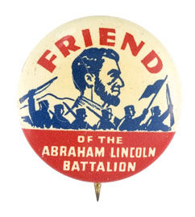
US reaction
Arms embargo on Loyalists and Franco
FDR not help Democratic Spain because supported by Catholic Church
Our actions helped condemn a nation to death
The Lincoln Brigade
The Spanish Civil War was a prelude to WWII
US reducing military strength as it went on

Slide 15
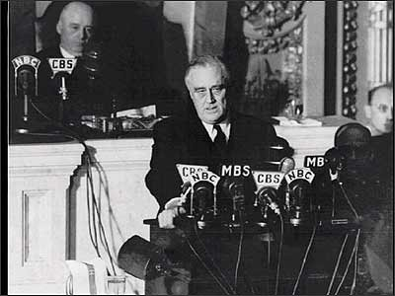
Appeasing Germany and Japan
1937 J attacks C
We keep trading since no official war
To invoke neutrality would mean to cut out China
Quarantine Speech
FDR urged efforts to stop aggressors with economic embargoes
Isolationists were outraged

Slide 16
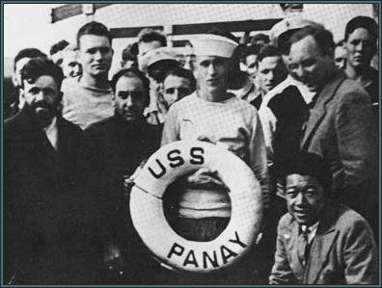
Panay
An American gunboat in Chinese waters
1937
Could have meant war, but Japan apologized
Compare to Maine Sinking
In Germany Hitler began rearmament reoccupied the Rhineland, occupied Austria, demanded the Sudetenland and was given occupied Czech, and the demanded the Polish Corridor

Slide 17
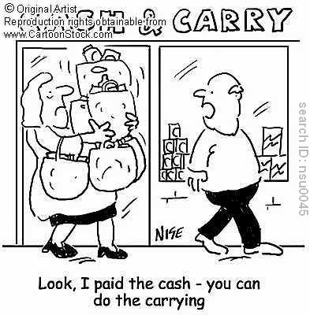
Hitlers Belligerency and US Neutrality
1939 Germ and Rus sign non aggression pact
Now AH can focus on Poland and Europe
US immediately declares neutrality
Cash and Carry good
Declare danger zones for no sailing areas
We favored Brit and France
Improved US economics
Factories crank back up

Slide 18
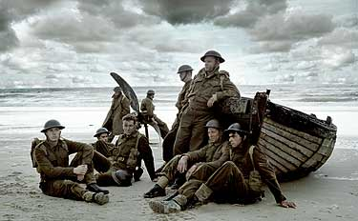
Aftermath of the Fall Of France
September 1 1939: Poland
From 1939-40 Phony war
Russia invaded Finland
Then Germany invaded Denmark, Norway, Holland, Belgium and France
Dunkirk
Churchill PM

Slide 20
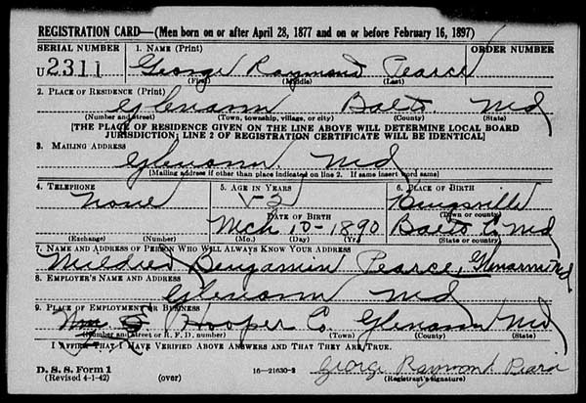
Frances fall leaves Brit on own
Hitler just had Brit and then all of Europe his
FDR called for two ocean navy
Congress appropriated 37b
First peacetime draft since Sept 40
Told LA we would uphold Monroe

Slide 21
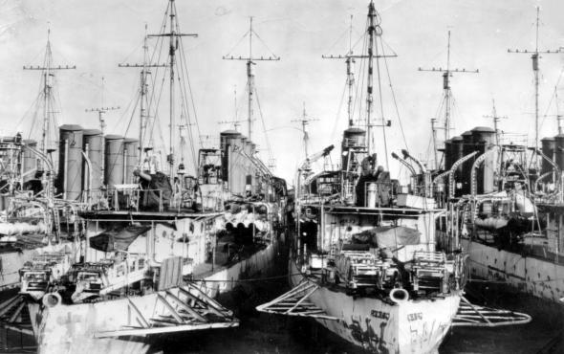
Destroyer Deal
Battle of Britain
German planned to attack air bases, destroy communication, get control of the sea, attack coast and send in paratroopers

Slide 22
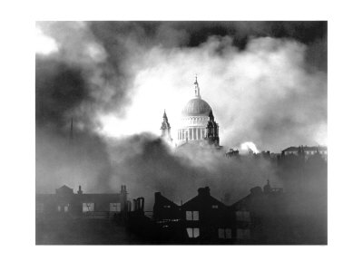
Britain could not defend direct attack
Prepared for attack with lookouts
Aug. 40 attacks begin
28 day Blitz

Slide 23
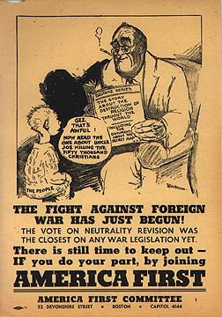
US got ready
Committee to defend America and America First Committee
50 destroyers for bases

Slide 24
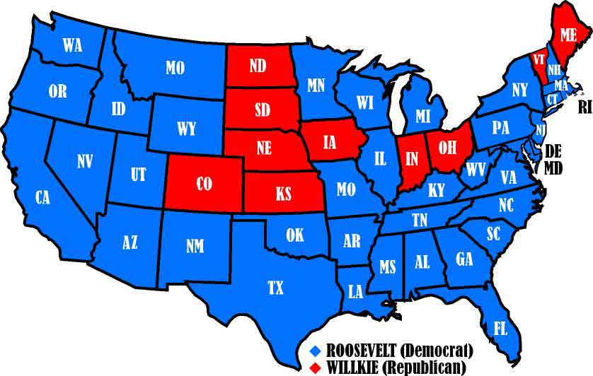
1940 election
Taft and Dewey likely for Repubs, but Wilkie gets it
FDR Repubs go for dictator idea
Both promised to keep US out of war
FDR wins

Slide 25
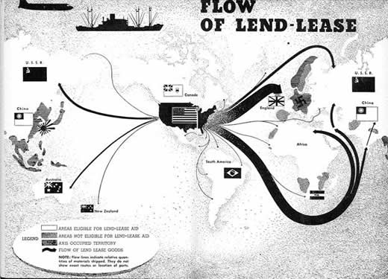
Lend Lease
Help a neighbor
Materials returned
Defend US
Ended neutrality
50 billion
Factories start working
Occupy Greenland
Critics: Would lead to convoys and war
Hitler looked at as act of war
Robin Moor sunk

Slide 26
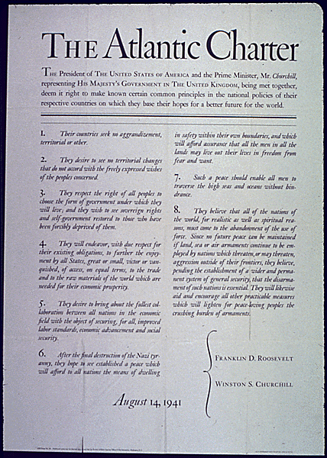
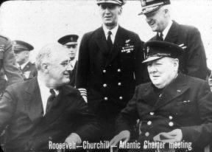
Germany invades Russia
Needed oil
US lend lease to Russia
Atlantic Charter with Brit: 1941
No territorial changes without consent of people
Democracy
New League of Nations
Liberals dug it
Isolationists condemn

Slide 27
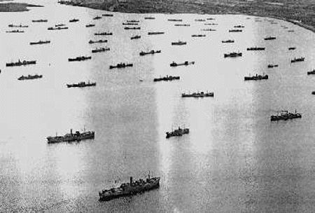
U Boats again?
Britain needed help getting supplies
FDR orders convoys as far as Iceland
Greer attacked
FDR orders shoot on sight
Merchant ships armed

Slide 28
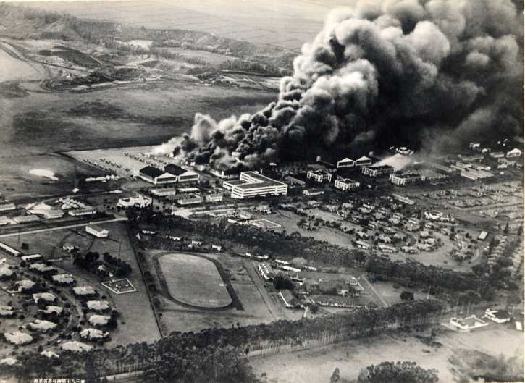
Heading towards Pearl harbor
Pacific?
July 1940 Japan proclaimed Asia for the Asians and invaded Dutch East Indies
We responded to invasion of Indochina by banning scrap Iron to Japan, but still let them buy oil
Germany invaded SU, Japan wanted ports
41 We froze their assets
Sept they met with us
While meeting with us the Japanese Fleet left
Dec 1 rejected our terms
Dec 7

