Slide 1
Chapter 2
The Planting of English America

Slide 2
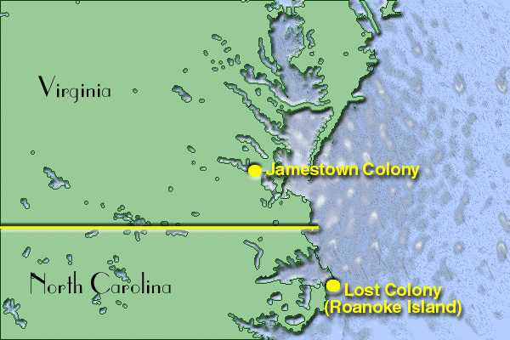
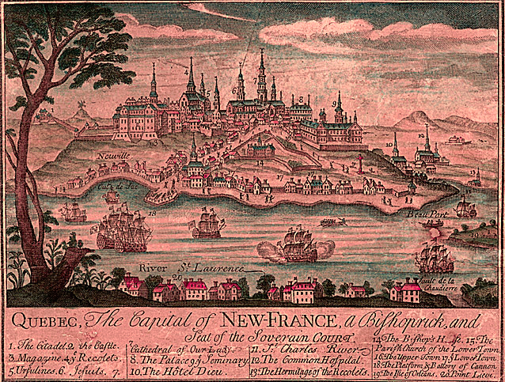
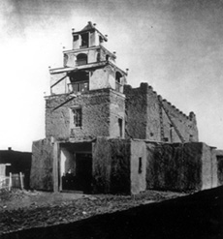
By 1600, the New World had been changed by European Influence
But North America was still basically untouched
Three new colonies would change that
1607: English at Jamestown
1608: French at Quebec
1610: Spanish at Santa Fe

Slide 3
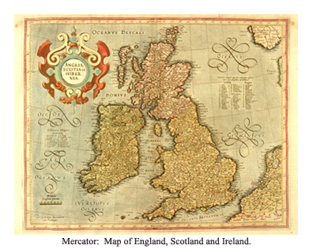
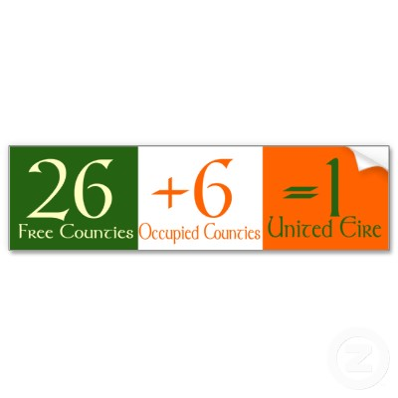
England’s Imperialist Stirrings
During 1500’s England divided by Religion, so no time for exploration
1530 King Henry VIII broke with church
Protestants and Catholics battled
1558 Elizabeth takes throne and peace ensued, but rivalry with Spain grew
Irish tried to throw off England by enlisting help from Spain, failed and were forced into the hands of English Landlords
Led to long term problems between Ireland and England

Slide 4
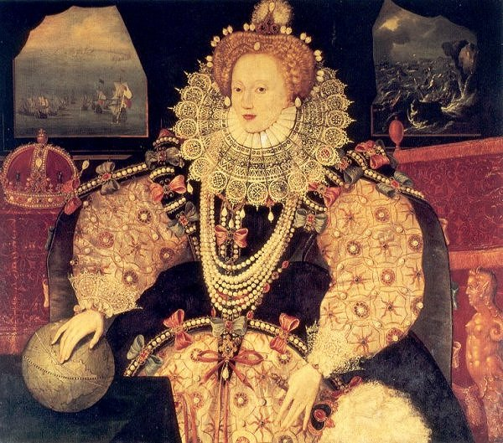
Liz energizes England
As England grew peaceful at home, English buccaneers grew active in the waters
Many times attacking the Spanish (Francis Drake)
Sir Gilbert heads to Newfoundland but dies,
His brother Sir Walter Raleigh attempts farther south
Roanoke : everyone disappeared
England not having same success as Spain

Slide 5
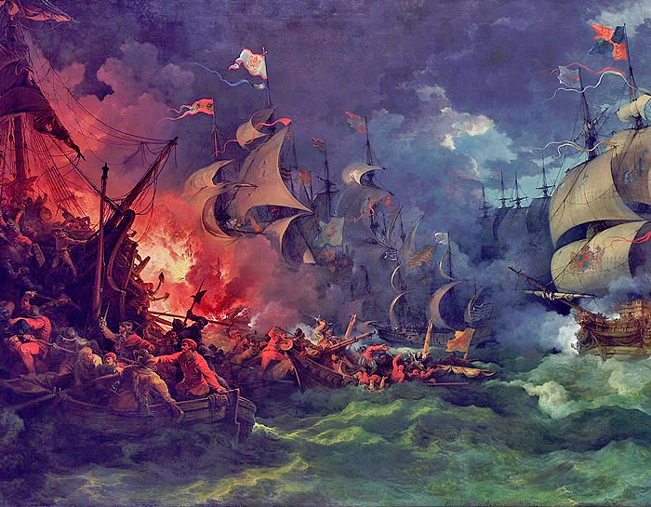
Spain falls
Spain builds armada to take on England
English Sea Dogs in smaller, faster boats defeat in 1588
Spain slowly loses power in Europe and the New World
England was now the master of the ocean
England blossomed culturally and economically as a new era evolved

Slide 6
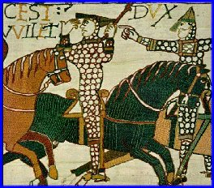
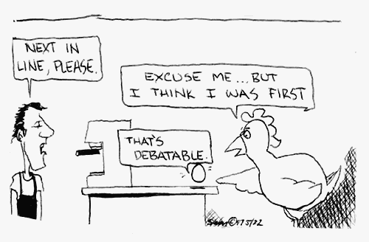
England’s Empire
17th century
England’s population growing
Landlords “Enclosing” land for sheep grazing
Many protestants felt pushed out
Economic depression pushed many farmers out
Outdated laws limited who could get land:
Primogeniture
Entailment
Companies looked to make money in the new world, but needed people willing to do the work: Joint Stock Companies
With no money and no future in England, was it worth taking a chance in the new world?

Slide 7
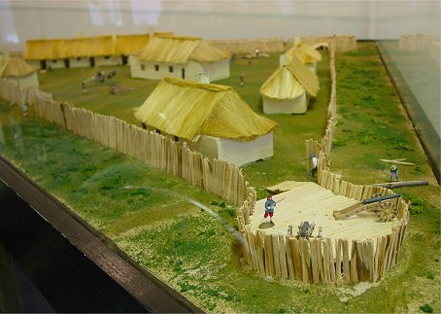
Jamestown
Virginia Company of London
James I gives charter
Promise of gold
Passage to Indies
Rich young men, not prepared, did not prepare
Charter: set of rules
Said they had “Same rights as Englishmen”
Landed at Chesapeake and immediately attacked
Worked way up river to place they called Jamestown
Easy to defend, but hot, muggy and mosquitoes
100 settlers (men) try: May 24 1607

Slide 8
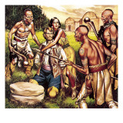
First years are horrible
40 died on way over!
Too busy looking for gold and not enough preparing
Enter: John Smith
1608: He who shall not work, will not eat…
Smith captured and symbolically saved by local Powhatan Indians
Pocahontas became middle ground between Natives and Settlers
Lived off animals and unfortunately even cannibalism
1609-10 60 of 400 survive the “Starving Time”
Gave up and started to leave, met by Lord De La Warr and went back to survive. Took a harsh policy with Natives

Slide 9
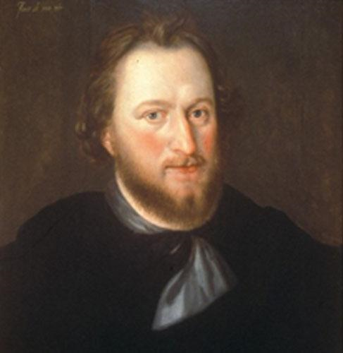
Cultural Clash
Powhatan was a chief who had created a confederacy
At first may have tried to use English to help him gain power
After 1610 relations strained
De La Warr used “Irish tactics”
Total War, effects everyone
1614 the 1st Pow war ended with marriage of Poca to Rolfe
1622 hostilities open, Rolfe killed
2nd war 1644,
“Perpetual war without peace or truce,” ended in 46
Assimilation not an option
Banished Natives from land
3 D’s Disease, Disorganization, Disposability economic function)

Slide 10
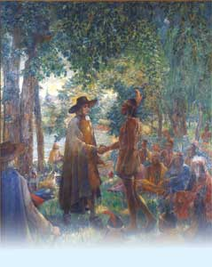
The Indian’s New World
Natives had had challenges before, but nothing changed them as much as Europeans
Some changes good and bad
Horses
Disease
As old die, lose history
Forced migration
Trade changed from barter to cash
Some even tried to go to England to trade directly
To survive, sometimes both sides had to compromise

Slide 11
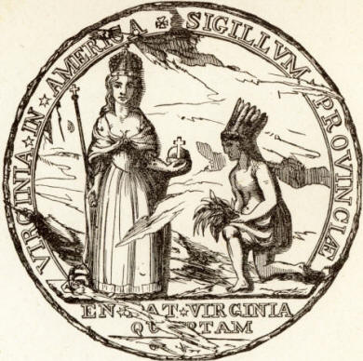
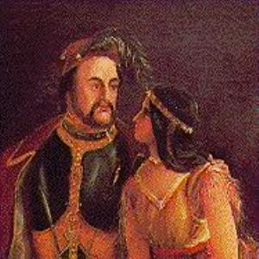
Virginia
Rolfe: father of tobacco
Savior of VG
Settlements growing, causes issue with natives
James I warned of dangers
1619 Dutch sell first slaves to English in new world
Indentured preferred, cheaper at first
Representative government
House of Burgesses
James revokes VG charter 1624
Now a Royal colony

Slide 12
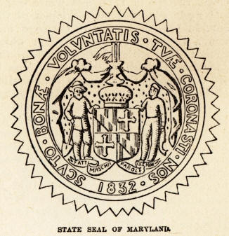
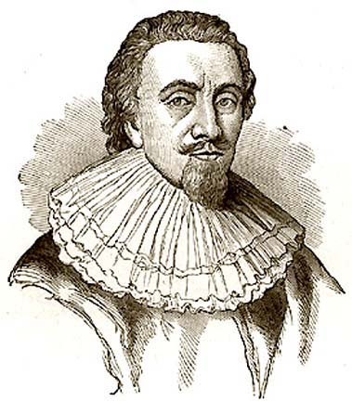
Maryland
1634
Lord Baltimore
Financial and religious
Huge estates to catholic relatives
Other back country farmers moved in: protestant
Caused tension and rebellion
Tobacco made money
Used indentured servants
Freedom of worship at outset
Act of Toleration 1649:
Toleration to all Christians
Death penalty to Jews and atheists

Slide 13
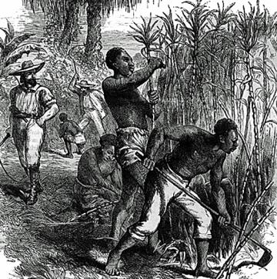
West Indies
British also active in W. Indies
Sugar basis of economy
Needed a lot of land and money
African slaves brought in
Depended on mainland for food
Some headed to Carolinas and brought slaves
And Barbados slave code
Staging area for slavery in new colonies

Slide 14
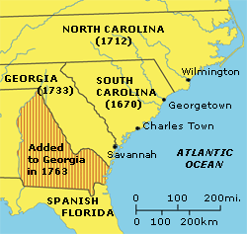
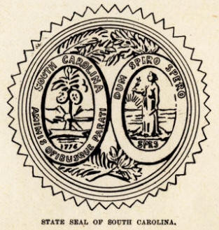
Colonizing Carolina
Civil war in England
King Charles kicked out by Parliament in 1629
Recalled in 1640, beheaded in 1649
Cromwell rules for about a decade
Colonization interrupted
When King comes back in 1660 known as Restoration
Carolina given to 8 men
Worked well with close islands
Slave trade
Tried to capture natives many sent to West Indies
Savannah Indians wanted to go to Penn for safety
Big raid by Carolina, natives extinguished
Rice was a big crop
Charleston becomes biggest port
Protestant
Catholic Spaniards not happy with Protestants so close

Slide 15
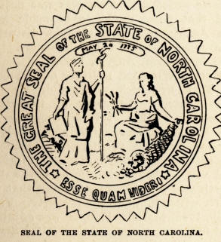
North Carolina
Some poorer people started trickling out of VG to the south
Squatters
Irreligious and hospitable to pirates
NC separated in 1712
Native attacks by and against from Tuscarora. With SC help chased them out to join Iroquois
Least aristocratic/more democratic
Did have slavery, but not as much as SC

Slide 16
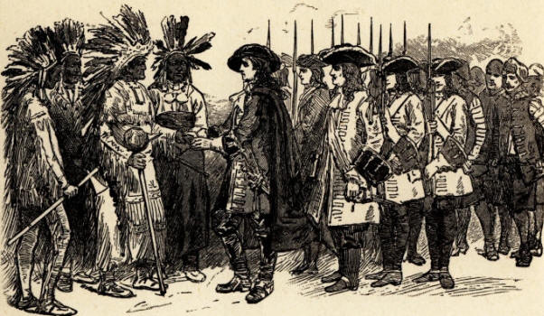
Georgia
1733
Last of 13
Buffer
Philanthropists started
Silk and wine
Debt prisoners
Oglethorpe
Good military leader and able to ward off attacks
Savannah melting pot
Germans, Scotts
Everyone Christian
but Catholics welcome
Slow growth, no slavery at first

Slide 17
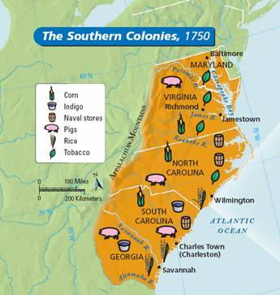
Plantation Colonies
All broad acres
Commercial agriculture
Slavery
Aristocratic
Less cities
No free schools or printing presses!
Some toleration
Soil butchery will lead to future issues

