Slide 1
Chapter 1
Finding a New Nation

Slide 2
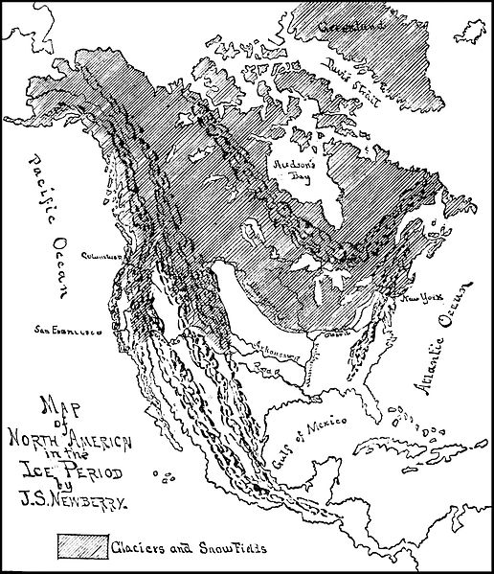
Shaping of North America
225 million years ago, the world was a supercontinent
Shifting and folding caused Mountains to form
N. A. is 10 million years old
Ice Age 2 million years ago
10,000 years ago, it melted and left country pretty much as we see it now

Slide 3
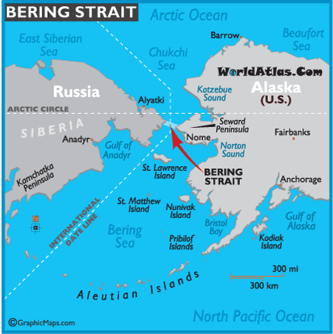
Peopling the Americas
Some question if the first people came by water, most feel they came by land
Bering Sea land bridge at the Bering straits
250 centuries of people coming over from Asia
Areas of America opened up

Slide 4
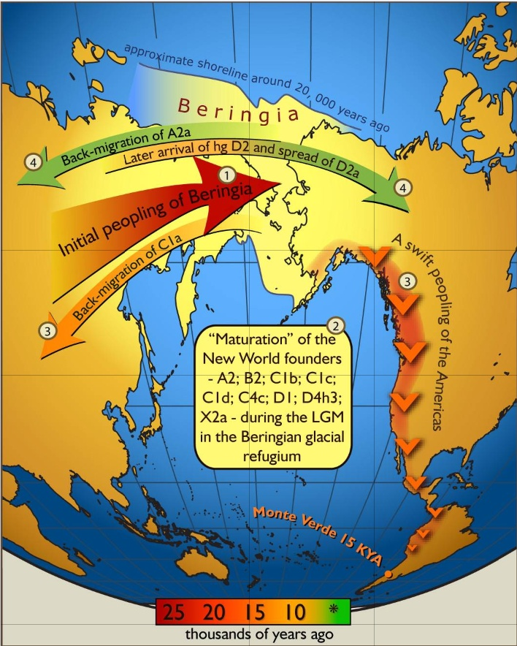
People slowly moved toward South America
Split into tribes
Grew corn
Did not have ox or horse
Built large civilizations
Sometimes took part in human sacrifice

Slide 5
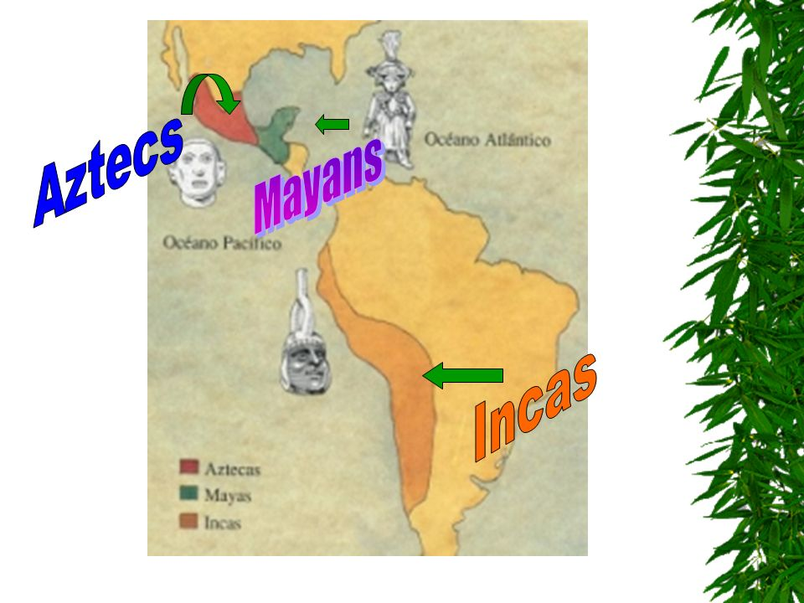
Some Earliest Americans
Incas, Mayans, Aztecs
Agriculture was basis of economy in SA and Mex
Farming made nomads
settle down

Slide 6
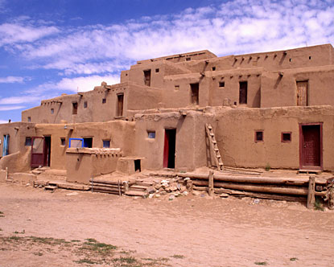
North America
Pueblo
Created irrigation systems
Mound Builders: Ohio River Valley, and Anasazi of SW
Most fell into decline by 1300 AD

Slide 7
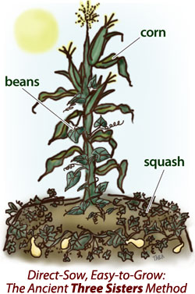
1000 BC farming made it to Atlantic
Three sister farming: Beans, squash, and Corn
Led to bigger populations

Slide 8
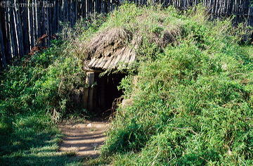
Iroquois of NE
Closest to civs of SA
Political and organizational skills

Slide 9
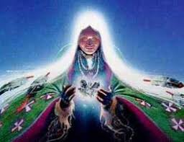
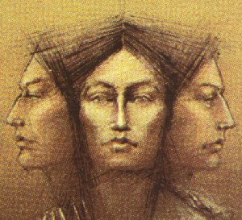
Most NA natives scattered
matrilineal
Lived with nature instead of control
1492 4 million Natives in NA

Slide 10
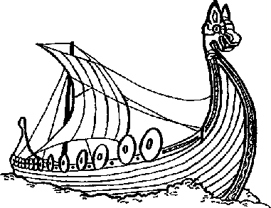
Indirect Discoverers of the New World
Europeans and Americans unaware of each other
Norseman came AD 1000
Did not last long
As Crusaders headed to fight they found different cultures and ways of living
Needed a cheaper way to get goods from East to Europe

Slide 11
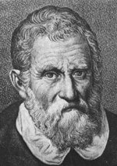
Europeans Enter Africa
1295 Marco Polo maybe comes back from China( Or did he?)
Needed new ships that could take the weather
New routes that were safer
Brought S. Africa within reach

Slide 12
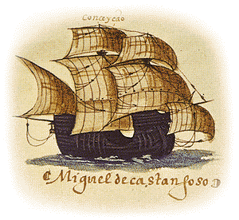
Portuguese
Set up trading posts, slavery
Used to work sugar plantations
Origins of modern plantations
caravels
Dias: made it around S Africa in 1488
De Gama: India
Spaniards under Ferdinand and Isabella step up their game

Slide 13
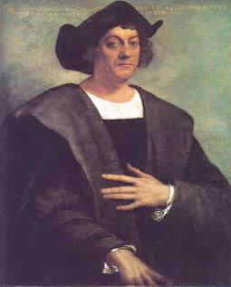
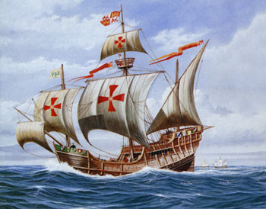
Columbus comes Upon New World
Europe wants cheap goods from East
Slave trade pushing for more contact
Renaissance pushed for new exploration
Knowledge was spreading faster due to printing press in 1450
Mariners compass

Slide 14
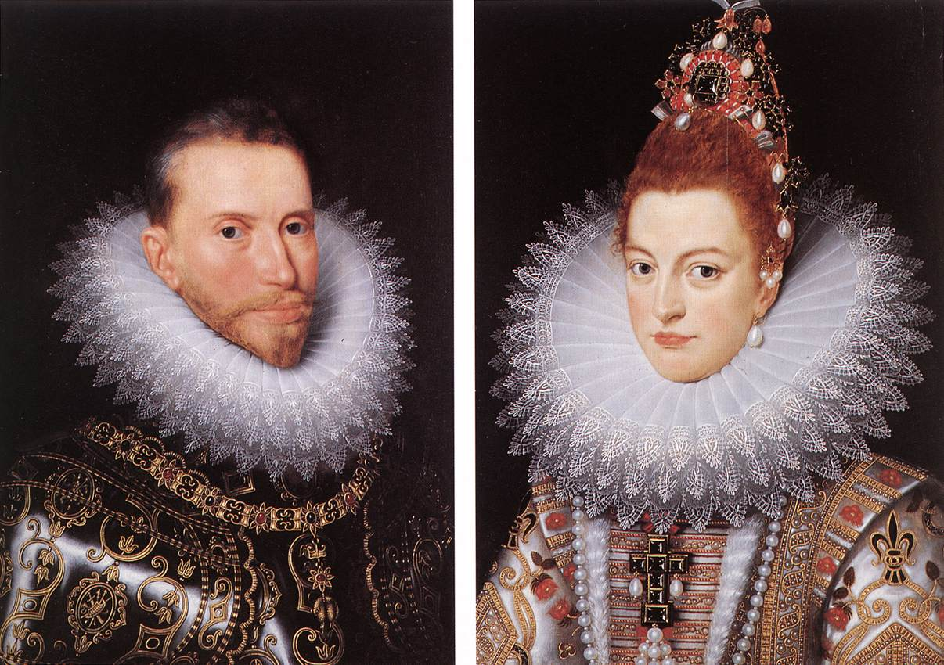
Columbus
Italian, hired by Spain
Six weeks no land, mutiny close
October 12 1492 Bahamas
Trying to find Indies and found a New World
Misnamed the people and territory

Slide 15
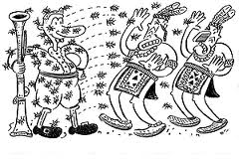
When Worlds Collide
Ecosystems collided
Many different animals and plants that increased European economy
Columbian Exchange:
Europeans brought new animals
Sugar cane
Germs and small pox
Natives contribute crops

Slide 16
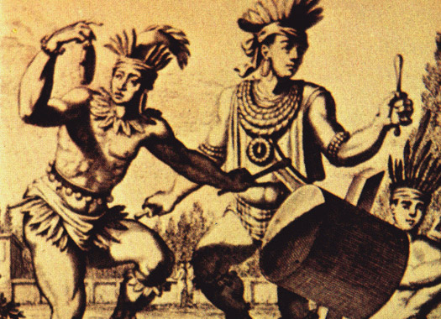
50 years of Spanish influence
Taino Natives went from 1 million to 200
Eventually 90% natives in new world die

Slide 17
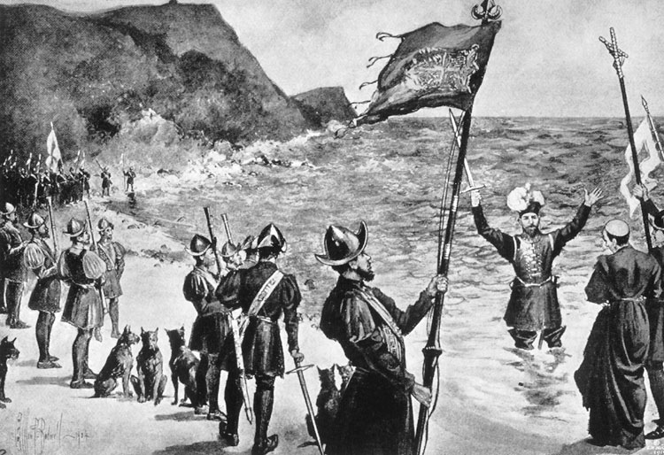
Spanish Conquistadors
Europe starts to see worth, especially in Mexico and South America
Treaty of Tordesillas 1494
Spain gets new world, Portugal Africa and Asia
Spain comes for God, Glory and Gold

Slide 18
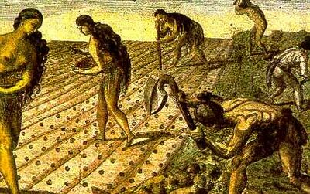
Conquistadores
Balboa: Discoverer of the Pacific
Magellan: around the tip of SA, but killed in Philippines
One vessel made it home, circumnavigate
Ponce de Leon: Florida
Coronado: Arizona and New Mexico
De Soto: crossed Miss. River
Pizzaro: Incas
Gold stores helped fuel capitalism
Encomienda: conquistadors set up plantations

Slide 19
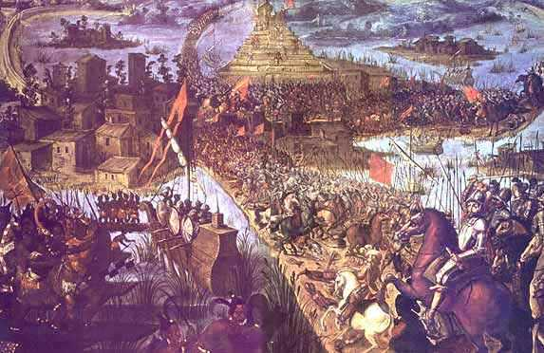
Conquest of Mexico
1519 Cortes left Cuba for Mexico
Marched on Tenochtitlan
Montezuma sent envoys with gifts, got Cortes more interested
They thought Cortes sun god
Battle broke out. Cortes takes city in 1521
Mexico's mix with Natives: Mestizo

Slide 20
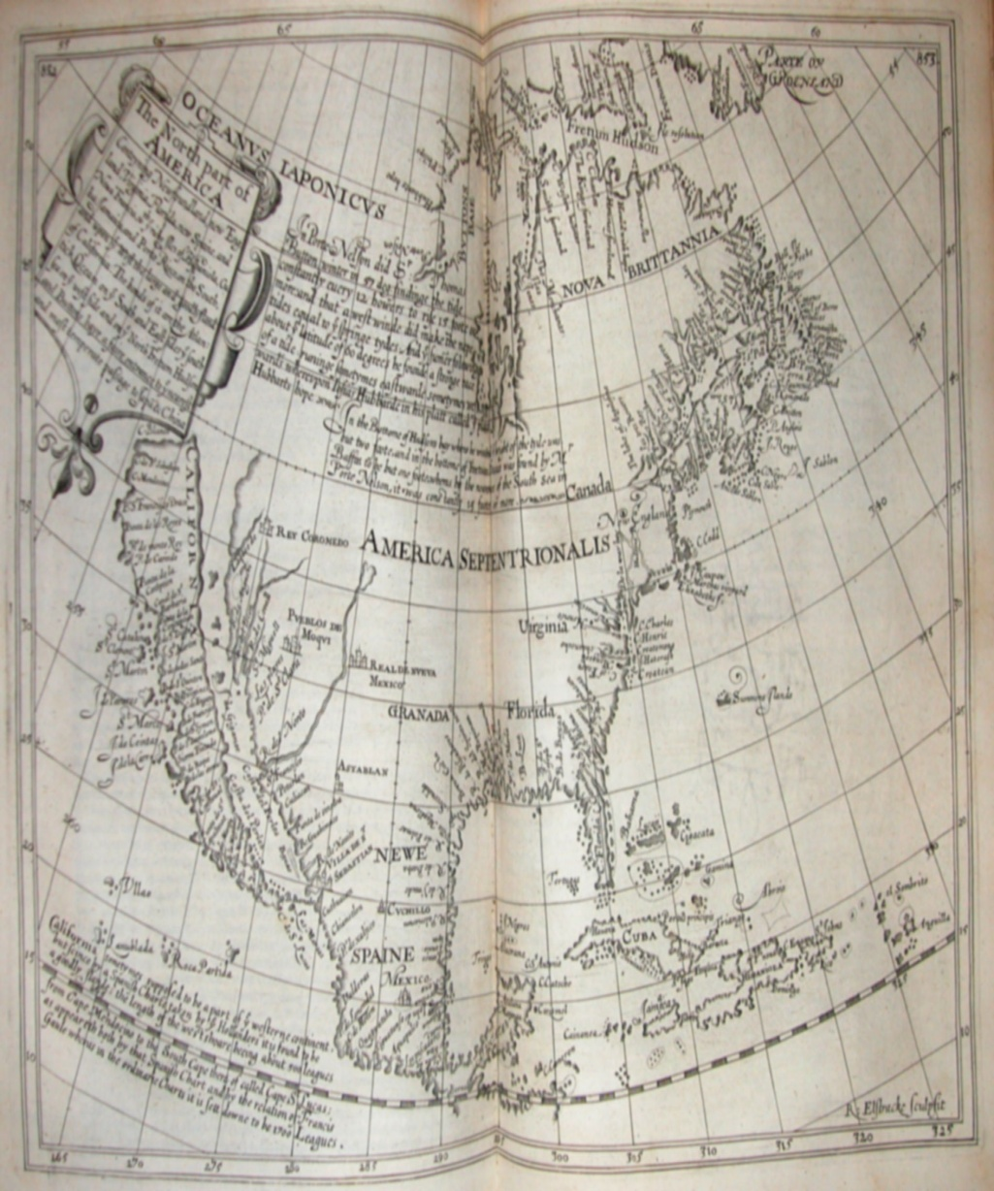
Spread of Spanish
Spanish civilization well entrenched
Colleges and cathedrals
Some competition with English and French
Spanish began to fortify
Build Missions
St. Augustine Fl 1565

Slide 21
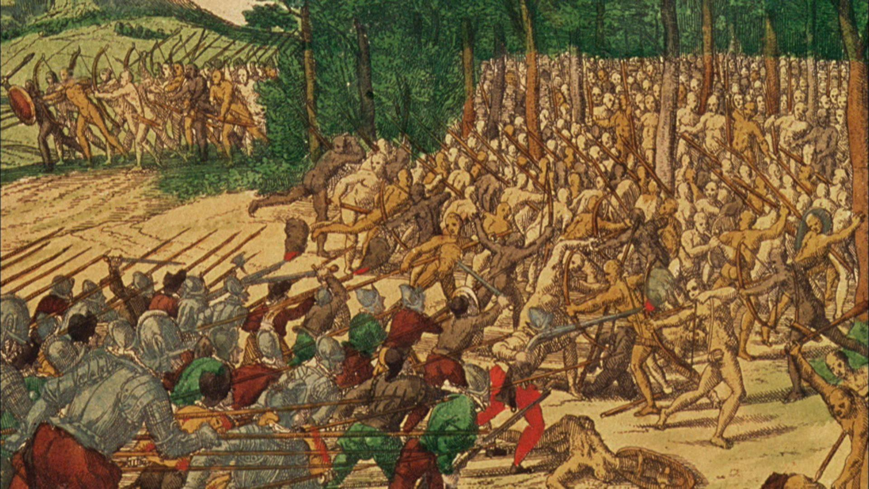
Coronado: Colorado River
Juan de Onate
Harassed Pueblo
Battle of Acoma: cut off survivors foot
Led to Popes War 1680: Pueblo strike back
colonies in Texas to buffer: Alamo

Slide 22
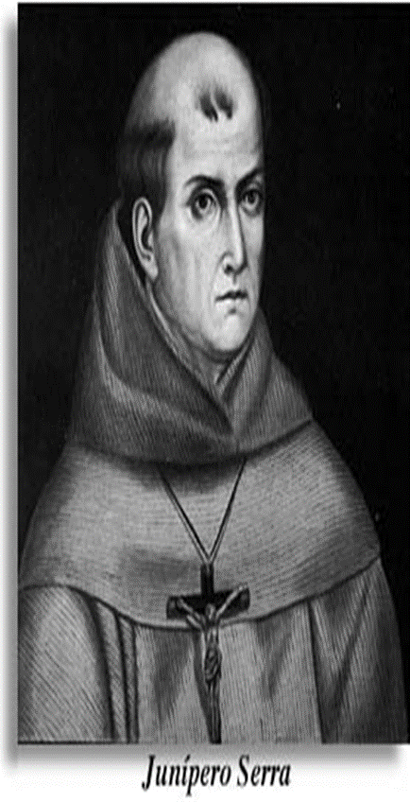
1769: Fr. Junipero Serra founded San Diego
The destruction outshined the construction
Important to remember that the cultures were intertwined and not separated

Slide 23
Explorer | Date | Destination | Impact on the Americas
Balboa
Magellan
Ponce De Leon
Coronado
De Soto
Pizzaro
Cortes
Serra

