Slide 1
Chapter 33
The Emergence of Woodrow Wilson

Slide 2
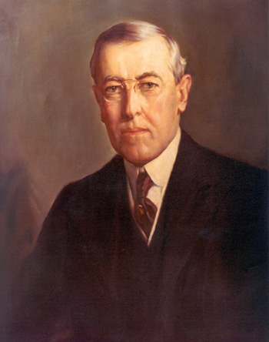
Wilson Who?
Democrats on outs since 1897
1902 Wilson President of Princeton
Wilson a Progressive Democrat
1910 New Jersey Governor
Wilson got in on bosses, but went against them
Went after Trusts
Wanted to give the state government back to the people

Slide 3
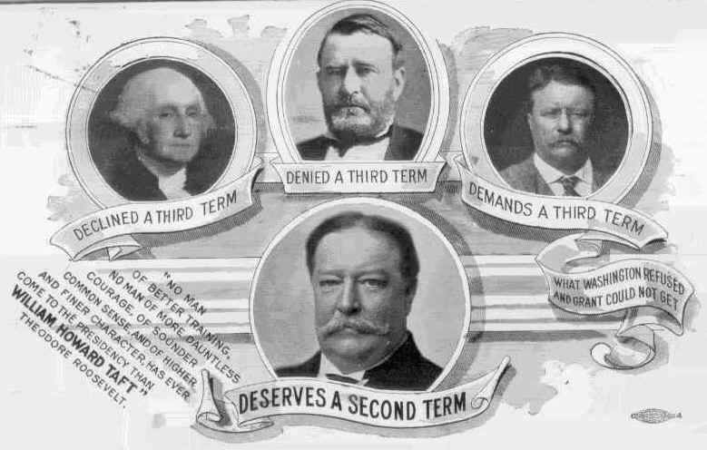
1912 Election
Wilson: New Freedom
Anti trust legislation, banking reform and tariff reduction
Aided by Bryan
Wilson: Small enterprise, free unregulated unmonopolized

Slide 4
Repubs split : Ugly between TR and Taft
Bull Moose: TR
New Nationalism
Repubs: Taft
TR: Croly’s view: consolidation of trusts and unions with agencies of DC
Women's suffrage
Soc. Welfare
Min wage
Soc. Insurance
Shot!

Slide 6
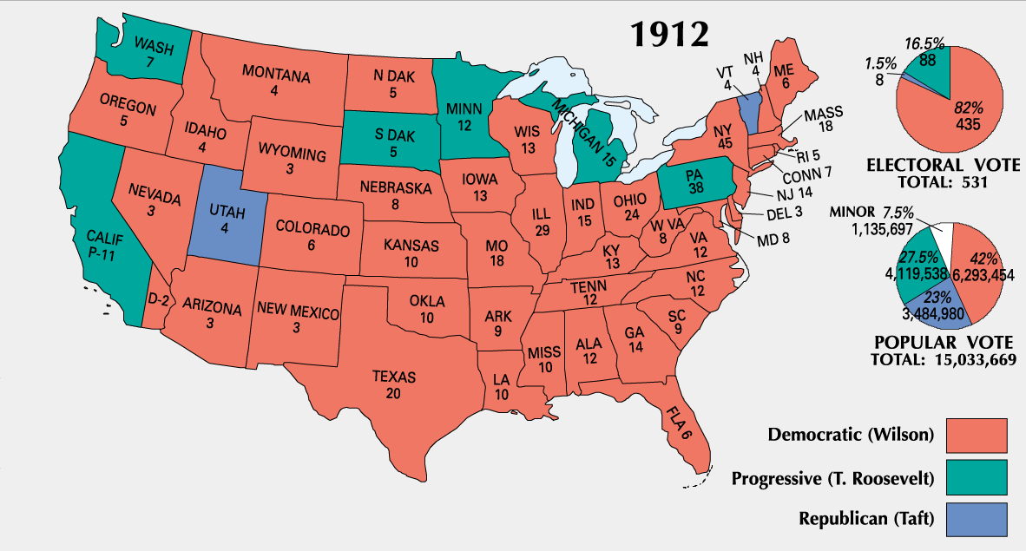
In the end, Progressivism won
Socialists did OK too!
TR killed self and party Bitten himself and gone mad)
1921 Taft Chief Supreme Court Justice

Slide 7
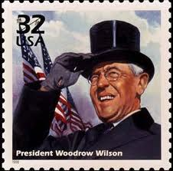
Idealist in Politics
Intellectual
Jeffersonian
Pious
Orator: Born half way between Bible and Dictionary
Loved Humanity in mass and not the individual
Compromise difficult

Slide 8
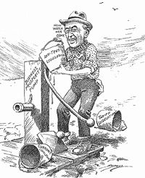
Tackles Tariff
Tariff
1913 goes in front of Congress in person
Broke tradition
Underwood Tariff
Reduction of rates
Reduction of import fees
Graduated income tax
Went on national tour when Congress tried to amend

Slide 9
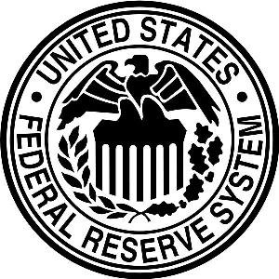
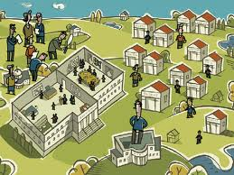
Wilson Battles the Bankers
1907 proved that inelastic money supply was a failure of Civil War National Banking Act
1913 plea for reform of banking system
Federal Reserve Act
12 districts
Paper money, easier to increase
Carried us through WWI

Slide 10
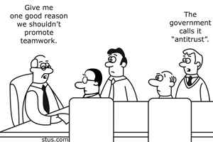
Trusts
1914 went to Congress again
Federal Trade Commission act of 1914
Crush monopolies
Clayton Anti Trust Act 1914
Protect workers
Legalize unions

Slide 11
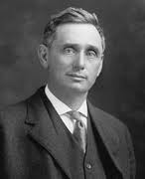
Wilson at high tide
Federal Farm Act 1916
Credit to Farmers, low interest
Warehouse Act 1916
Loans on Security of staple crops
Lafollette's Seaman’s Act 1915
Workingman’s compensation Act 1916
Adamson Act 1916
Brandies appointed to SC broke. 1st Jewish person on bench

Slide 12
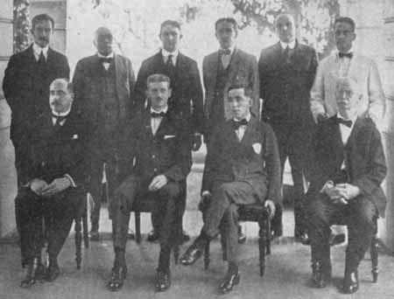
New Direction in Foreign Policy
Anti-imperialist
War on Dollar Diplomacy
Repeal Canal Tolls Act of 1912 in 1914
Jones Act: 1916
territorial status to Philippines in 1946
Japanese Relations in CA
Japanese not allowed to own land. Possible war?
Bryan helped smooth over

Slide 13
Haiti Marines sent in to protect Americans after rev.
Dominican Republic as peace keepers
Virgin Islands purchased

Slide 14
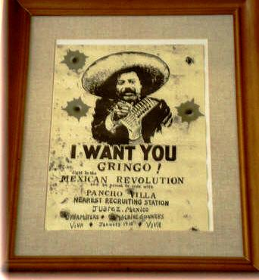
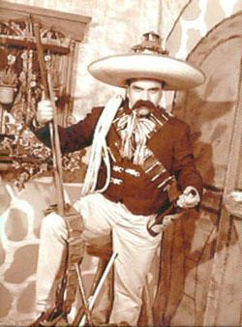
Moralistic Diplomacy in Mexico
Mexico had a revolution
1913 50,000 US sent to Rio Grande to keep peace
Installed Huerta: Full blooded Indian
Many Mexicans start coming to US
Borderland cultures
Hearst Pushing for war
Wilson not like Huerta gave money to Pancho Villa

Slide 15
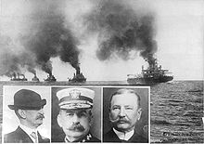
Mexico (cont)
1914Tampico
-American sailors arrested
-US takes Vera Cruz harbor
-Almost go to war
-ABC powers: New president
Carranza
1916 Pancho not like Carranza and starts problems
16 Americans killed
Pershing sent to kill him
Withdrew in 17 war

Slide 16
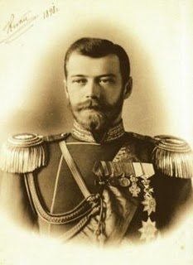
Thunder Across sea (It is Germany, but not the suasages)
Franz Ferdinand assassinated
The alliances aren’t so secret anymore
War is evident
Will the US get in?

Slide 17
Precarious Neutrality
Both Sides want us on their side
Brit sees connection in culture and technology (cable)
Germany saw connection in countrymen
1915 Spy papers? Now we can’t trust Germans

Slide 18
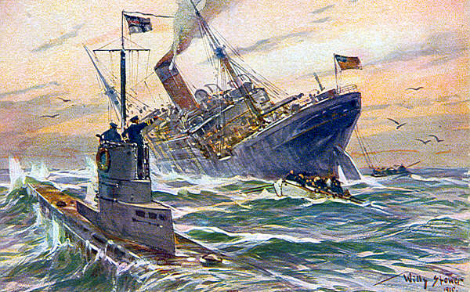
America Earns Blood money
War pulled us out of recession
Morgan advanced allies
Central powers upset
Harassment of US shipping canals
1915 announced submarine warfare against Brit. Isles
Do best not to bother neutrals, no promises

Slide 19
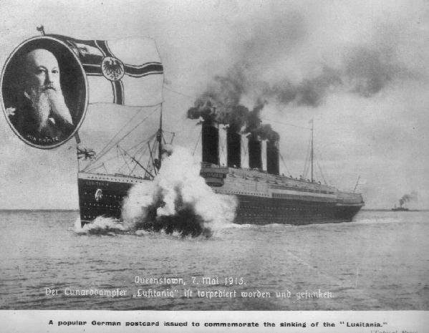
Sinkings
May 1915 Lusitania
4200 cases of ammunition
Wilson not want war, warnings send Bryan packing
Arabic: Brit with Americans
1916 Sussex
Sussex pledge
Germ. Not sink unarmed without warning, but US needs to get blockade of Germany lifted, US ignores last part

Slide 20
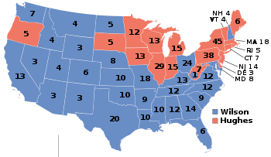
Wilson Wins Reelection 1916
Wilson v. Hughes
TR was clamoring for war, hurting Hughes chances
Hughes looks like he was going to win
Wilson ready to concede in morning

