Slide 1
Chapter 24
Reconstruction

Slide 2
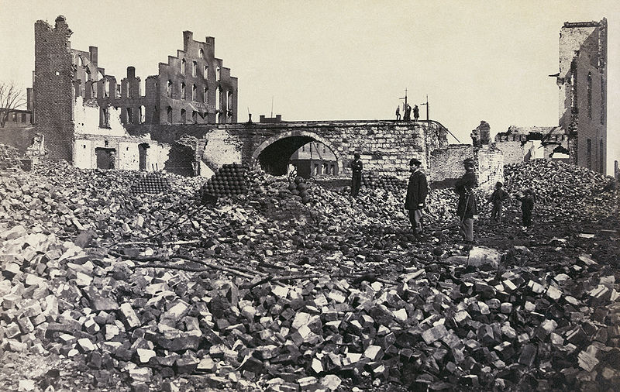
How does this picture of the south illustrate the difficulties they will face in the following areas:
Politically?
Socially?
Economically?

Slide 3
Questions the country had to face
How would the south be rebuilt?
How would the liberated African Americans fare as free
How would the south come back in?
Who would direct the reconstruction and readmission
What would be done with leaders?

Slide 4
Ordeal of Reconstruction/Problems of Peace
Cities leveled
Economics stopped
(factories, banks, business)
Transportation crippled
Agriculture crippled
Slave labor system collapsed
Men hitching themselves to plow
Aristocrats humbled
Investments gone, house gone, slaves gone, money gone
Lots of anger and hatred

Slide 5
Freedmen Define Freedom
Emancipation
different in different parts of country
Some said that until the states voted it slavery was legal
Gradual or Immediate?
Even the slaves opinions differed:
Some slaves had helped their masters hide silver and goods
Some joined union in pillaging
Steal from master, they had been stolen from
Sometimes depending on union troops victories, free then slave, free then slave

Slide 6
Some tried to head west and were killed: Texas hanged as sign
Day of Jublio: Gathered slaves and told free: What does that mean?
Many wanted to find family
Many headed West: Exodusters

Slide 7
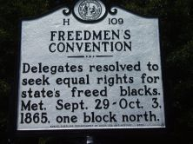
Conventions of Freedmen
Groups who gathered and fought for rights, did not find welcome arms in S, needed friends in Congress

Slide 8
Freedman’s Bureau
Freed slaves unskilled and no education
No money or property
1865 FB started: Welfare agency
Food, clothing and education to freedman
40 acres a mule
Howard:
Put in charge
College in DC

Slide 9
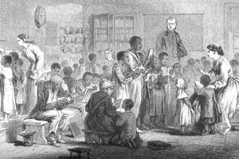
Education success: 200,000
Wanted to read for success, but also for Bible
Sometimes whole families go to school
Corrupt people put in charge
Johnson: White supremacist view: Killed it in 1872

Slide 10
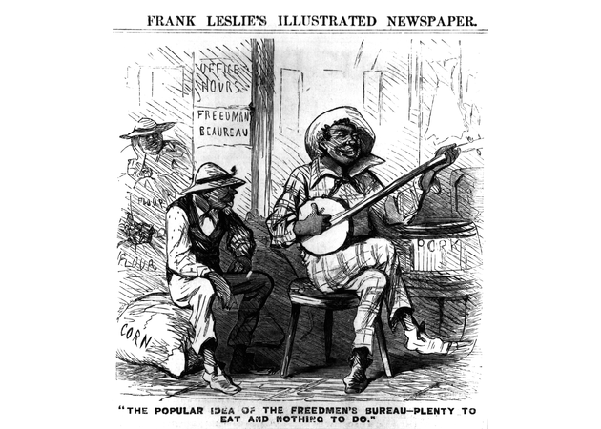
What is the historical context of this cartoon? (What is happening at this time?)
What is the artist’s point of view in the cartoon?
What is the author’s purpose ?

Slide 11
Freedmen’s Bureau Seen Through Southern Eyes
Plenty to eat and nothing to do.

Slide 12
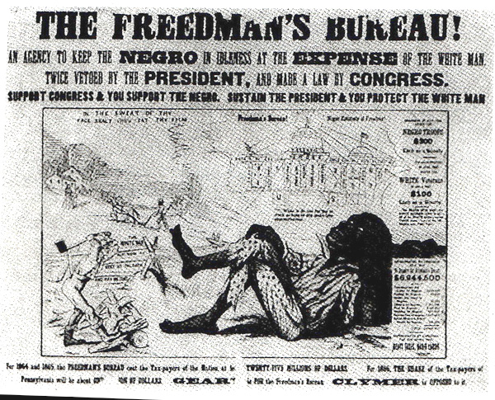

Slide 13
Johnson: Tailored President
Humble beginnings
No school, appr. Tailor
Taught himself to read and wife taught him to write and math
Moved to Tenn at 17
Champion of poor whites, owned a few slaves
Against the planter elite
Two fisted stump speaker
Refused to secede with his state

Slide 14
War gov. when Tenn was redeemed
Union party needed candidate
Drank to get through typhoid, came off bad in speech
States righter and supporter of Constitution: Parrot

Slide 15
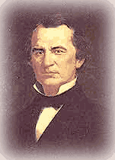
Did not understand the north
South distrusted him
Demo never accepted by the Repub
President not elected
Wrong man, wrong place, wrong time

Slide 16
Reconstruction

Slide 17
Presidential Reconstruction
10% Plan: South never left, so just get them back in ASAP
Proclamation of Amnesty and Reconstruction (December 8, 1863)
Replace majority rule with “loyal rule” in the South.
He didn’t consult Congress regarding Reconstruction.
Pardon to all but the highest ranking military and civilian Confederate officers.
When 10% of the voting population in the 1860 election had taken an oath of loyalty and established a government, it would be recognized.

Slide 18
Congress did not react well
Rad. Repubs got worried lose power
Tried Wade Davis:
Required 50% of the number of 1860 voters to take an “iron clad” oath of allegiance (swearing they had never voluntarily aided the rebellion ).
Required a state constitutional convention before the election of state officials.
Enacted specific safeguards of freedmen’s liberties

Slide 19
Wade-Davis Bill (1864)
“Iron-Clad” Oath.
“State Suicide” Theory [MA Senator Charles Sumner]
“Conquered Provinces” Position [PA Congressman Thaddeus Stevens]
Pocket Veto
President Lincoln
Wade-Davis Bill

Slide 20
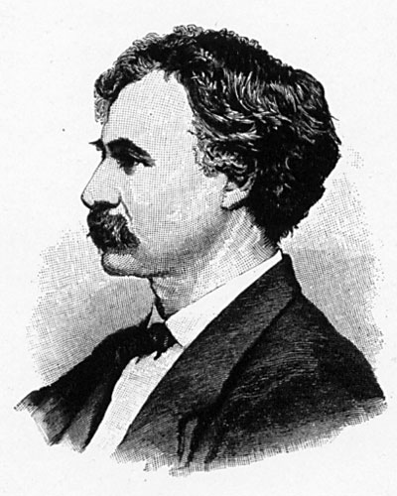
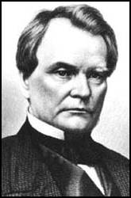
Wade-Davis Bill (1864)
Congressman Henry W. Davis (R-MD)
Senator Benjamin Wade (R-OH)

Slide 21
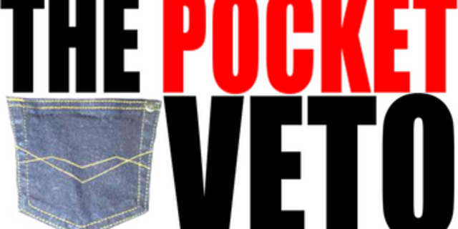
Lincoln pocket vetoed
RR mad, would not seat LA delegation after 10%

Slide 22
Repubs split
Moderates: restore quick, on Congress terms
Radicals: S needed to be punished
Felt that Johnson would help them to punish aristocrats
Johnson did not betray South
Had a 10% plan too, but added more

Slide 23
President Johnson’s Plan (10%+)
Offered amnesty upon simple oath to all except Confederate civil and military officers and those with property over $20,000 (they could apply directly to Johnson)
In new constitutions, they must accept minimum conditions repudiating slavery 13th Amendment, secession and state debts.
Named provisional governors in Confederate states and called them to oversee elections for constitutional conventions.
1. Disenfranchised certain leading Confederates.
EFFECTS?
2. Pardoned planter aristocrats brought them back to political power to control state organizations.
3. Republicans were outraged that planter elite were back in power in the South!

Slide 24
Black Codes
South had new power with Af/Am counting for representation, but needed to be sure Af/Am could not use power

Slide 25
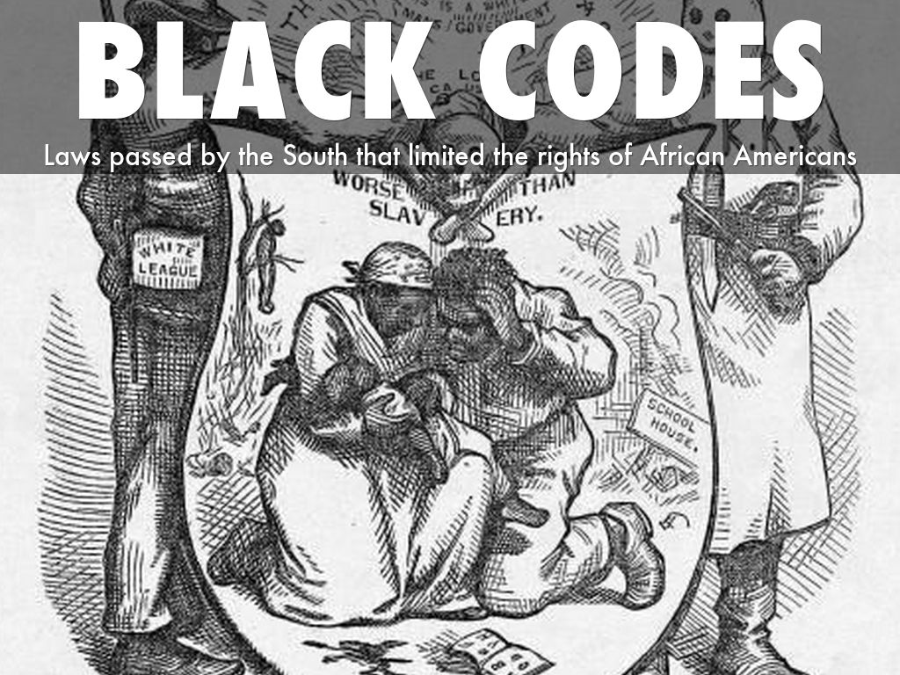
Pass Black Codes:
Regulate affairs with free blacks
Ensure a labor supply
Jump contract: Forced back to work
Pre-emancipaton status
No jury, no renting, no marriage
Mocked freedom
Many became sharecroppers and tenant farmers

Slide 26
Pass Black Codes:
Regulate affairs with free blacks
Ensure a labor supply
Jump contract: Forced back to work
Pre-emancipation status
No jury, no renting, no marriage
Mocked freedom
Many became sharecroppers and tenant farmers

Slide 27
Congressional Reconstruction
1865 Southern states showed up for Congress
Many old Confed leaders showed up too
Most natural leaders, but not a good idea
Republicans mad

Slide 28
North had cart blanche during war
Morill Tariff, Pacific RR act, Homestead Act
Had shut the door on the south
Repubs worried now. Slaves count as person=vote
Everything done could now be undone

Slide 29
Johnson Clashes
1866 AJ vetoes FB for the first time
Congress strikes back with Civil Rights Bills 1866
Citizenship for blacks and hits codes
Johnson vetoed: Sir Veto
overridden

Slide 30
Congress set out to turn Civil Rights bill into amendment 14
Conferred rights, citizenship, no vote, reduced rep of electoral college if Af/Ams could not vote

Slide 31
Disqualified old confeds from office, guaranteed federal debt, repudiated state debt

Slide 32
Swing Around the Circle
Controversy between congress and AJ continued
10% govs had been strictest on black codes
Congress tried to extend Freedman’s and pass Civil Rights

Slide 33
Congressional elections on the way so AJ tries for support
Went to dedicate a statue and win support
Swing around the circle
Hurt his cause

Slide 34
Republican Principles and Programs
Veto proof congress
Moderates and radicals still fight
Sumner: Radical Leader of Senate
Stevens House
Wanted to be buried in a black cemetery

Slide 35
Rads: Tried to keep south out as long as possible
Both agreed blacks must have vote

Slide 36
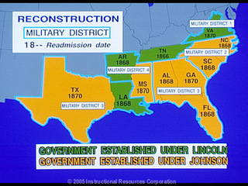
Reconstruction by sword
Divide South into five districts
Race Riots in S, needed to bring order
General in charge of each
Kept Southerners out of vote for a while
Rads worried states would come back and amend.
Wanted 15th to make sure Af/Am protected

Slide 37
Was reconstruction legal?
i. e. Ex parte Milligan: military courts not try civilians
Southern states quiet about Rad ideas
Southern states start to make constitutions to get back in
By 1870 most back on track, but as soon as Union left power changed hands

Slide 38
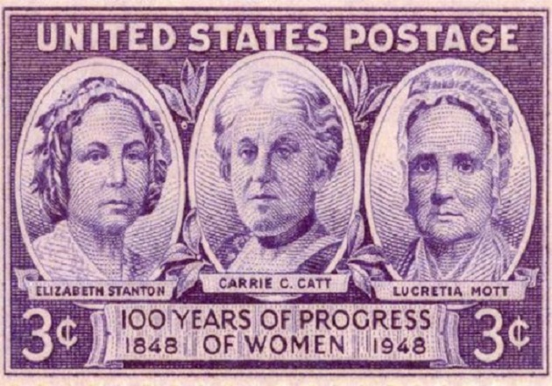
No Women Voters
13, 14th and 15th passed, but nothing for women
Stopped fighting during war, focused on slavery
Wanted the word sex added to 15th amendment, but was not

Slide 39
Realities of Reconstruction
Blacks Limited freedom
Suffrage was slow coming
Even North was not allowing blacks to vote

Slide 40
Black Reconstruction (still part of realities)
Short time
Af/Am earn some places in gov. mostly Congress
South fought vote
Scalawags and Carpetbaggers
Corruption 100,000 from an 8,000

Slide 41
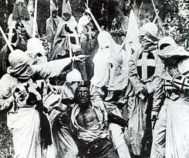
Klan
Secret organizations popped up to stop Af/Am from getting power
KKK 1866 in Tenn
Fear and intimidation
Force Act 1871

Slide 42
Impeachment plank
RR hate Johnson
Accuse him of womanizing
Wade would become pres
Tenure of Office Act of 1867
President needed senate approval for removal of appt
His cabinet not his appointees
Rads wanted to protect Stanton, he was spying
Trying to get Johnson in trouble

Slide 43
Not guilty
1868 Stanton dismissed
House had no problem and impeached and found guilt
Senate not so quick
One vote
Did not want to weaken president

