Slide 1
Chapter 5
The Eve of Revolution

Slide 2
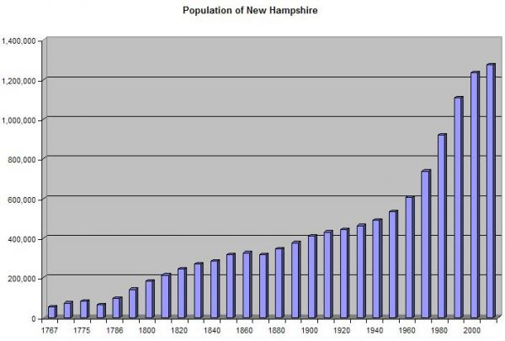
Conquest by Cradle
Population growth 1700: 300,000
1775 2.5 mil
Most of that number born here
Young and a threat to old culture in England
Most east of Alleghenies

Slide 3
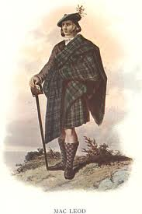
Mingling of Races
Melting pot
Germans: Penn Dutch
Scots Irish, (Scot lowlanders)
Squatters, violent, but good frontiersmen
Led Paxton boys in 1764
Other cultures too, but most did not feel connected to crown
Cultures intermarried
African American culture starting too

Slide 4
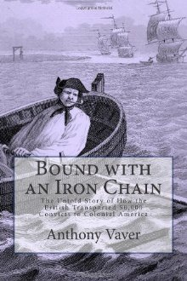
Structure
More equality, but not perfect
No nobility
Most making it on own
Closer to Rev, started to see stratification
Wars had left many widows
Not enough land in original colonies so caused expansion
South, wealth is in hands of a few
“Jayle Birds”
African Slaves, N condemned but profited

Slide 5
Clerics, Physicians and Jurists
Agriculture ruled
Tobacco in South
Middle Bread Colonies
Fishing
Commercial Trade
Triangle Trade
Industry secondary
Lumbering
Shipbuilding
Trade imbalance, had to look outside of England to sell goods
French in W. Indies
1733 Molasses act to try to stop money from leaving

Slide 6
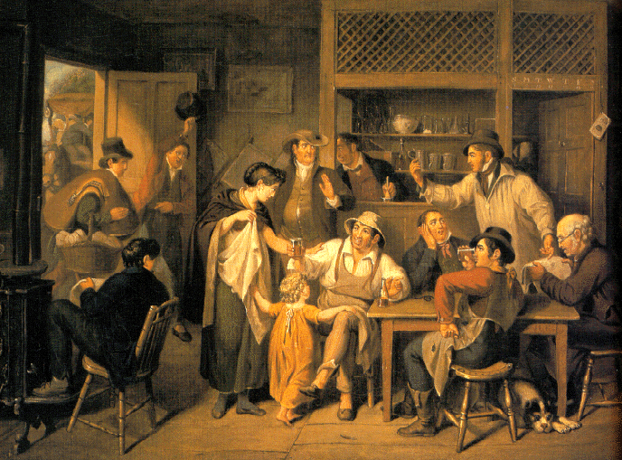
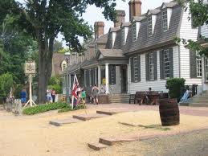
Horsepower v. Sail power
Transportation big issue
1700s first roads and bad
Taverns as social places
Inter-colonial postal system

Slide 7
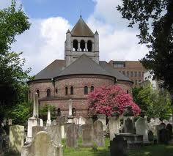
Denominations
2 tax supported churches
Anglican and Congregational
South more British (Anglican), but no Bishop
Congregationalists more radical for revolution
Not perfect, but more tolerant in US

Slide 8
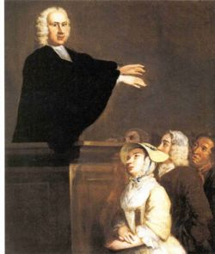
The Great Awakening
1700s less commitment to Religion
Puritans had too many rules and religion
No energy
New teachings suggested no elect
Arminius: Free will!
Time for a revival

Slide 9
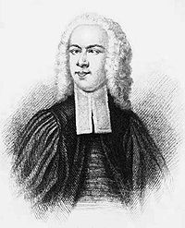
1730s-40s
Started in MA by Edwards
George Whitefield next
Traveled colonies
Old lights vs. New Lights
Led to missionary work
New colleges
First Spontaneous movement of American people

Slide 10
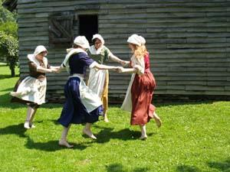
Schools
English believed school for rich
Puritans had more school, but for Bible reading
Even then for boys only
Some schools in middle, almost none in S
School was a lot of religion and classics
1750 saw a change in some colleges subjects

Slide 11
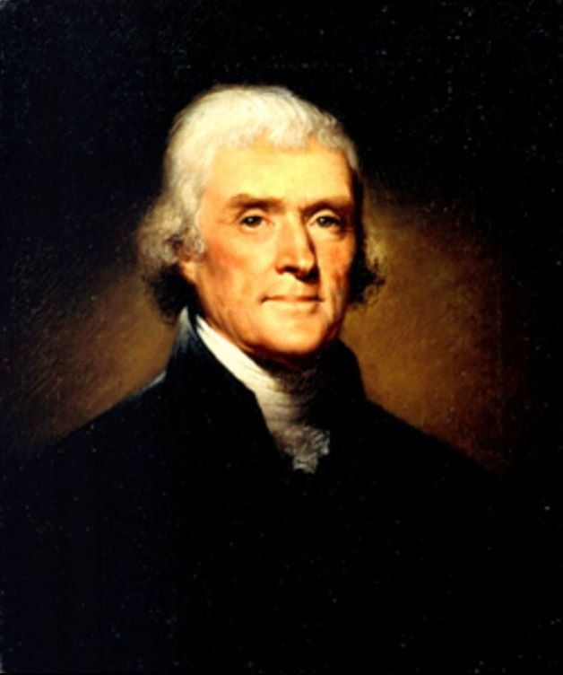
Provincial Culture
Still connected to British culture
Too busy to start too much of their own
John Trumbull: early US artist
Peale: George Washington portraits
Benjamin West, John West painters
Early writers far and few
Wheatley: female and a slave
Franklins: Poor Richards
Science slow to grow, but getting better
Based on practical ideas in US

Slide 12
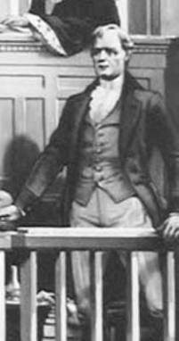
Pioneer Press
Books expensive
Some private libraries
Printing presses did the best they could
Columns: written by Roman sounded names commenting on public good
1734: Zenger Case
Went after gov.
Defended by Hamilton a former Indentured servant
Not guilty, beginning of Free speech

Slide 13
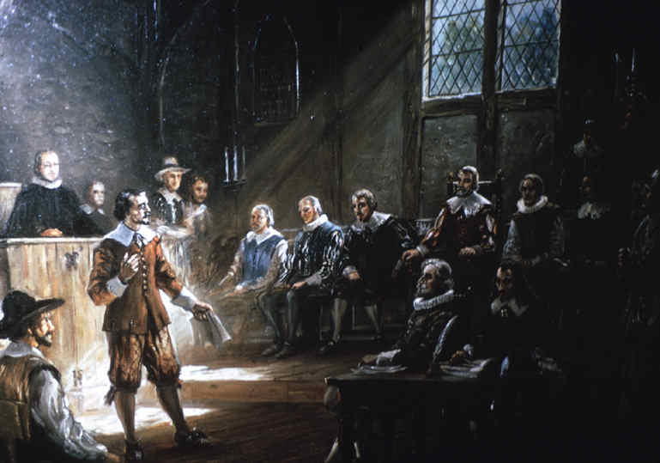
Politics
Most colonies had Royal Govs
But also 2 house legislative
Lower house usually had vote
Some govs, not good
Colonies had purse strings
London gov let colonies develop identities
Voting
Religious
Male
Property
More democracy then England

Slide 14
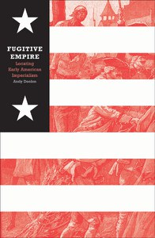
Colonial Folkways
Tough life
Plenty of food
Lacking comforts
No running water
Candles
Not a lot of free time
Social events like Barn Raising and weddings
Outdoor activities
Lottery!
Holidays, but some religions not allow
Colonies starting to unite

