Slide 1
Chapter 4
Life in the 17th Century

Slide 2
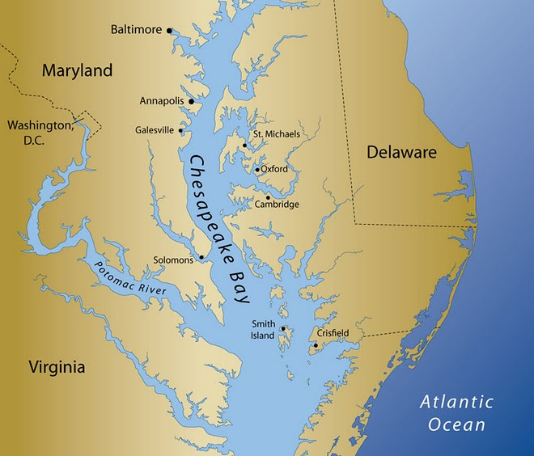
Unhealthy Chesapeake
FIRST: NOT AN EASY LIFE
Malaria, Typhoid and Dysentery…Oh MY!
½ of people in VG did not see 20
Slow growth, single men, few women…do the math

Slide 3
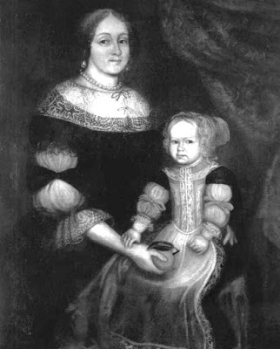
Harder on women
Slow growth, immigration
Eligible women did not remain single long
Families fragile, hard to find mate, hard not to die
Lots of unmarried mothers
THEN
Eventually began to survive
More women =families
VG and Maryland in top three pops by 18th century

Slide 4
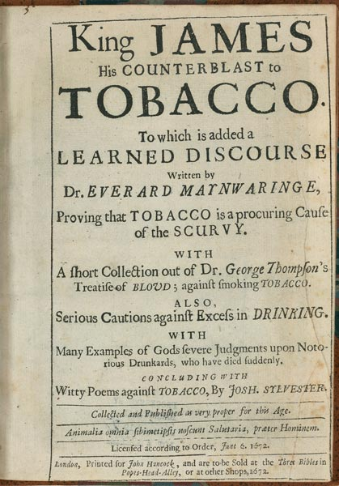
Stinking Weed
Ches. Perfect for Tobacco
Took toll on soil
Always need new land
Aggravated Natives
Prices fell due to overproduction
Answer, make more?
More Tab. =more labor
Families too slow to grow, Natives die

Slide 5
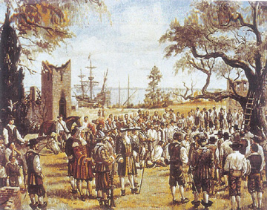
Headright System
If you pay passage, 50 acres
7 yrs service
100000 by 1700
At first pretty good system, but failed over time
Even when released, if have no money, have to work for master for bad wages

Slide 6
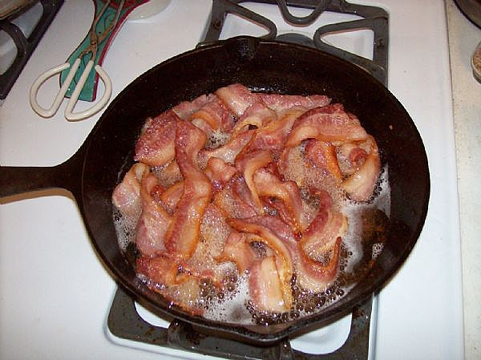
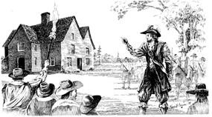
Bacons Rebellion
After a while a lot of poor freemen were wandering the roads
1670 VG disenfranchised them
1676 1000 revolted led by Bacon, 29 yrs old
Resented Berkley’s friendly policy with Natives
Bacon attacked Natives
Chased Berkley from Jamestown, burned capital
Bacon suddenly died
23 hanged, Berkley called home
Woke up serious fear in the minds of upper class, needed new working class

Slide 7
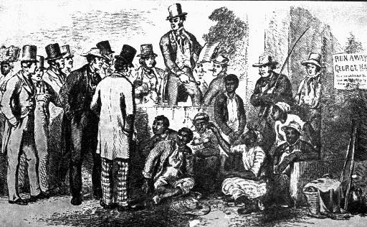
Colonial Slavery
10 million Africans brought to New World in 3 centuries
400,000 in US
1680s saw change, able to focus on profit
Post Bacon

Slide 8
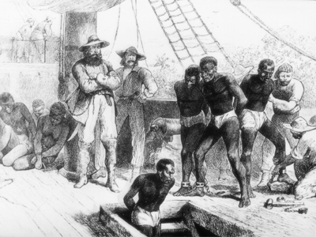
Until 1698 Royal African Company = monopoly,
Then anyone with a ship could do business
Rhode Islanders
Most from West Coast of Africa
Worst part was Middle Passage
Ended on auction blocks
Slave codes evolved to separate slaves and servants
Began a systematic racism that still exists

Slide 9
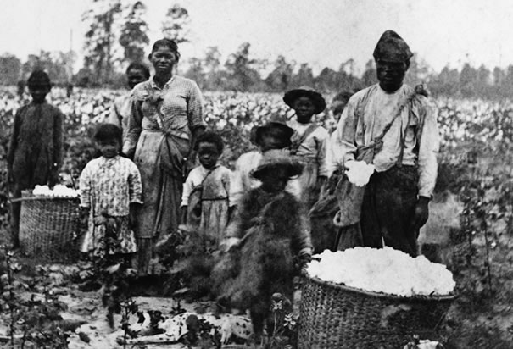
Africans in US
Deep south worst (Carolina)
Hardest work, had to have constant new replacements
Chesapeake was a little more forgiving, but still not good
Chance to see extended family
More women, led to growth by natural reproduction
Creation of a slave culture
Language, custom, religion

Slide 10
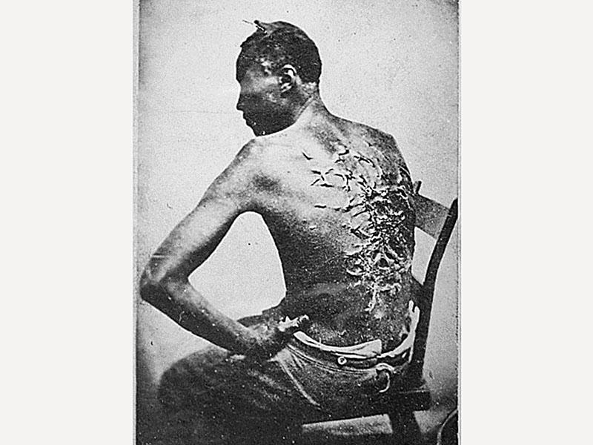
Slaves contributed to American culture
Speech, religion, folkways
Many skilled artisans
Pined for freedom

Slide 11
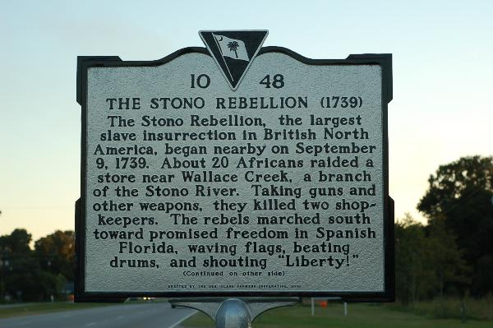
Rebellions
New York 1712
Slave revolt
12 whites
21 Af/Am executed
1739 Stono
SC
Stopped by militia

Slide 12
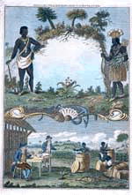
Southern Society
Hierarchy developing
Big planters with Large numbers of slaves had power: FFVs
Even rich hardworking at first, no time to sit back, but later more reserved

Slide 13
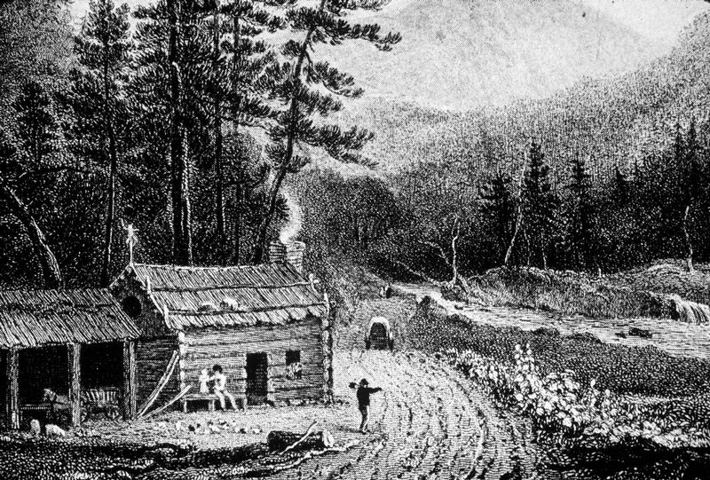
Largest group= small farmers
Maybe had 1 or 2 slaves
Hand to mouth existence
Merchant class slow to emerge, not a lot of cities
Waterways important for transport
Bad roads, led to bad transportation issues

Slide 14
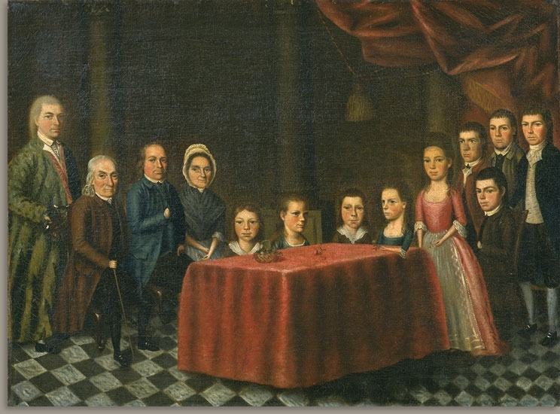
New England Family
Clean water, cool temps
Added 10 years by coming to New World
70 yrs old!
Came as families
Natural repro
Early marriage
Lots of kids, but took toll
10 kids normal brood
8 survive
Stable family

Slide 15
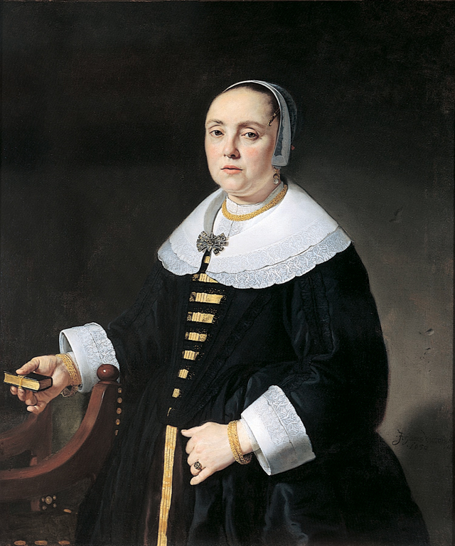
Women did not have property rights like in S, but did in Old England
Not vote
Morally weaker
Some spheres of influence: Midwifery
Divorce rare:often ordered reuinited

Slide 16
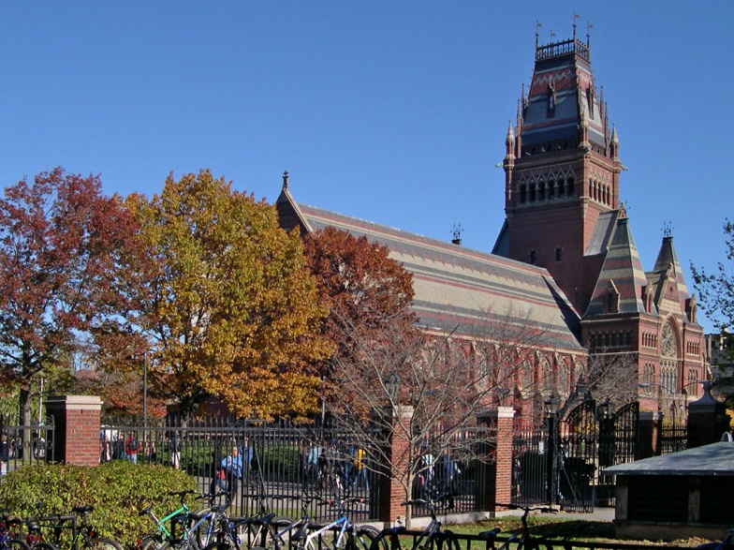
Life in NE Town
Small villages and farms
Religion connected them
Organized towns
Militia
Each family got land
Education: Bible
Harvard 1636
Limited Democracy in church and gov

Slide 17
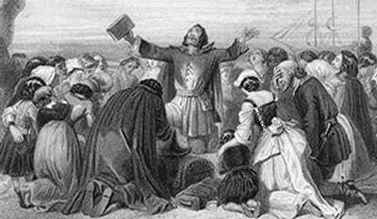
Half Way Cov and Witches
Preachers worry losing faith
Preach Jeremiads
Sermons that scolded parishioners
Seeing a decline in conversions
Needed new way to get people in the fold

Slide 18
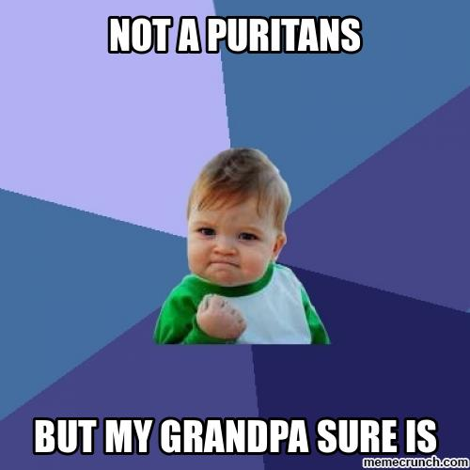
Baptism, but not full membership to non converted children
The line of elect and blurred
Gave women more presence in church

Slide 19
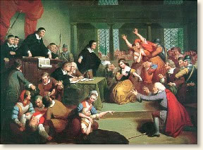
witch
Salem MA
Witch hunt
20 dead
Common in Europe
City vs. farmland
1693 Gov. forbid
20 years later, the witches forgiven
https://www.youtube.com/watch?v=3MmV42tUjfs
https://www.youtube.com/watch?v=fB1OWwFTZ8U

Slide 20
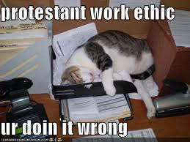
New England way of Life
Work ethic drove the NE colonies
Less ethnically mixed
Tough weather, but good soil
Different crops then south, slavery not profitable
They had impact on land, and land impacted them

Slide 21
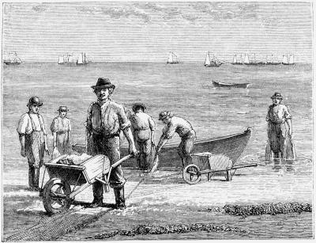
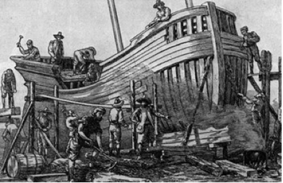
Definition of Land: Own vs. Use =battle with Natives
English brought animals that had impact
Shipbuilders and traders
Fisherman
Yankee Ingenuity spread across country

Slide 22
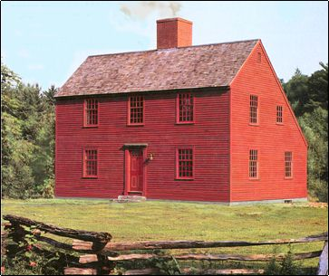
Early Settlers
Schedules set by sun
Agriculture economy
Women limited to inside work, men outside
Simple, but better then if they lived in England
Some class issues, but since most in same boat, more equal
Nature made everyone equal

