Slide 1
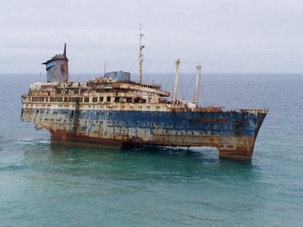
Chapter 10
New Ship of State

Slide 2
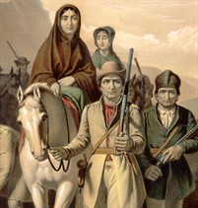
Growing Pains
Population on rise
Mostly rural
Mostly E of Appalachian
Judged by outsiders
Trouble with Spanish and British along far frontier, trying to get them to abandon US

Slide 3
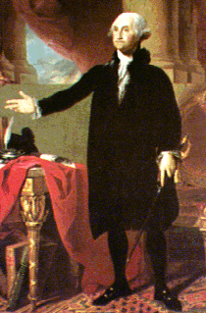
GW for Pres
Only pres ever unanimous
Some say did not seek office
Hero
Set up Cabinet
TJ: State
AH: Treasury
Knox: War

Slide 4
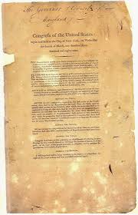
Bill of Rights
Did not want another convention, could lose everything
Madison wrote and directed through Congress
Gave specific powers to Fed and states to meet the needs of everyone
Passed around same time:
Judiciary Act 1789
Attorney General

Slide 5
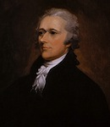
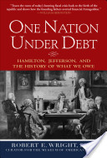
Hamilton Revives Public Debt
Hamilton
Smart, but cold
Loved US, but not us
Upper class fan
Make policy for upper class
Trickle down
Needed to get US to have good credit
http://www.youtube.com/watch?v=LBSuwa8mf9o

Slide 6
Hamilton’s Plan | B Bank of US | E Excise Tax | F Fund at Par | A Assume State Debts | T Tariff
What does it mean?
Why is it significant?

Slide 7
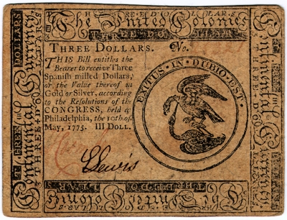
Fund at par: Pay off bonds at face value and with interest
People did not believe gov. would do so were selling to speculators
Shows people and other countries we pay debts
Assume all state debts: 21.5 million
States that owed a lot felt great, those that did not, were not thrilled
Make states feel responsible to gov

Slide 8
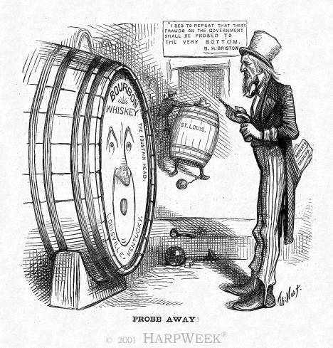
Custom duties…
Hamilton: Father of National Debt
National debt, national blessing
Tariffs and Taxes to get money to pay all this
First Tariff: 1789
Money and protection
Excise tax: ON WHISKEY!
Pay for debts

Slide 9
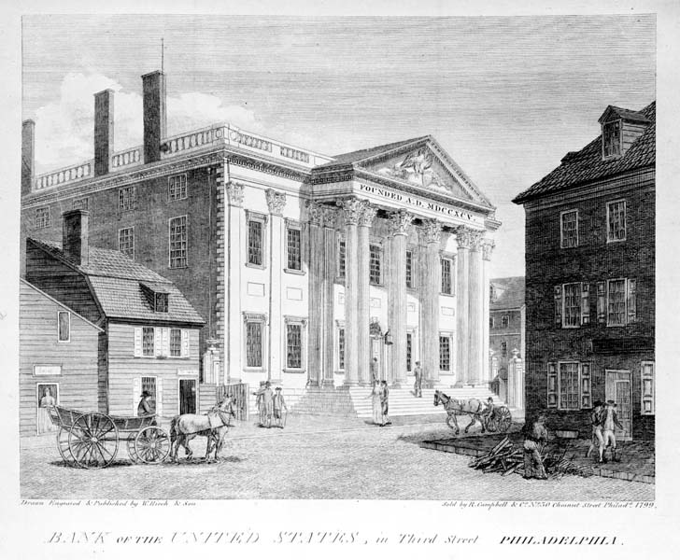
Jefferson Battles Bank
Bank of US
Model from England
Gov. owned stock in bank
Keep fed. Money there
Sound and stable national currency
Jefferson against: Not in Constitution
Strict vs. loose
AH says: Necessary and proper
1791: a go 20yr charter

Slide 10
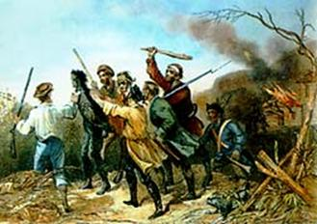
Mutinous Moonshiners
1794
SW Penn
Farmers hurt by tax
Torched buildings and tarred and feathered collectors
Tax collections come to a halt

Slide 11
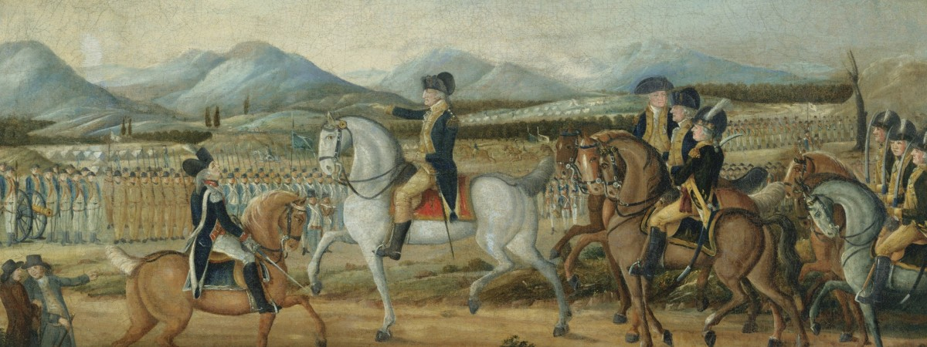
Washington summoned soldiers and led, Hamilton took last distance
Whiskey Boys dispersed
Federal Government showed would put down rebellions
Showed gov could work, TJ said brutal use of force

Slide 12
Hamilton’s plan: cornerstone of America’s financial system
Strengthened the government politically as well as financially
Established strong credit
Loose Construction
Anticipated the Industrial Rev
Report on Manufacturers
BUT…..
Jefferson opposition emerged due to encroachments on states rights
Created something new

Slide 13
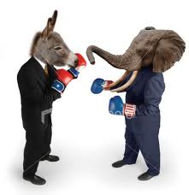
Political Parties
Founding fathers did not envision PParties
Organized opp. Seemed against unity
No national party had ever existed in US before
Factions had only existed on issues (kept in Congress)
But from now on, It is on!
1792-3
Hamilton Federalists
Jeffersonian Republicans
Two party system had begun
https://www.youtube.com/watch?v=pnCuwV29eBQ

Slide 14
Federalists Vs. J. Republicans https://www.youtube.com/watch?v=_KnPB37YB7I
What class?
Support business or farm?
Favor Central or State gov?
View of the common people?
Leaders?
Linked to what country?
Trusts/Distrusts
Feds | J Repubs

Slide 15
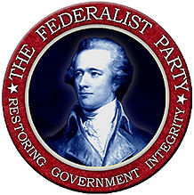
Federalists https://www.youtube.com/watch?v=_KnPB37YB7I
Emerged from Pre constitution party
Gov of upper class
Rich: had time to study issues
Intelligence, education, culture
Distrusted common people
Central government
Encourage business
Pro-British
Lived on Atlantic Seaboard
Adams, Hamilton, GW, Jay
Fed quotes:
John Jay: “Those who own the country should govern it”
Democracy too important to be left to people!

Slide 16
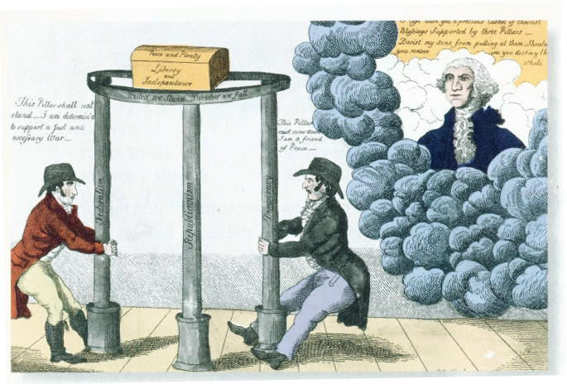
Jeffersonians
Rule of the people, gov. for the people
However: only those that could be literate enough to inform themselves and had land
Best govt. govn’d least
Appealed to middle class and underprivileged (Yeoman)
States should have power
Strict interpretation
National Debt: Curse
Agrarian
Freedom of speech
No tyranny
Pro French
TJ, Madison

Slide 17
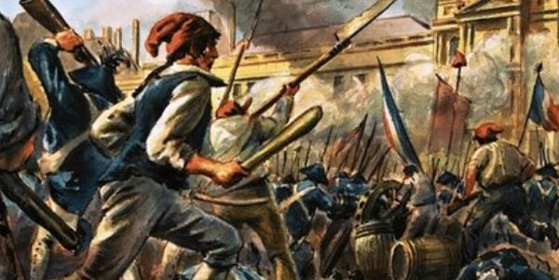
French Revolution
Single most important issue separating Feds and Republicans
Initial reaction to FR: everyone in US happy at first: Just like us
1792 France goes to war with Austria and Prussia: we support them
Then France said they were a republic: we were happy

Slide 18
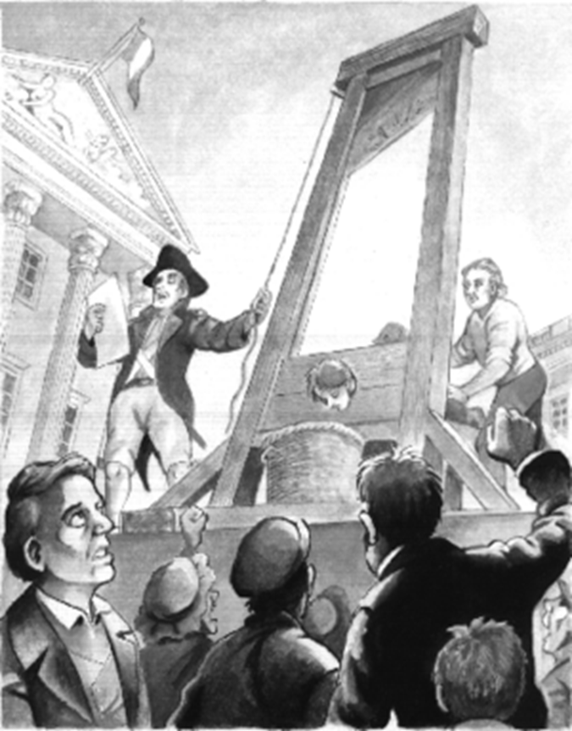
Then the Reign of Terror: We were not happy
King Louis XVI, wife, Marie Antoinette beheaded
Jeffersonian said bloodshed bad, but oh well
Feds worried about their necks
Becomes world war
Brits in war: need allies

Slide 19
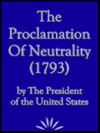
GW and Neutrality
US obligated to help France under Franco-American treaty 1778
Jeffersonian (not TJ) party said we must honor
GW wanted to avoid war
US weak
TJ and AH agree
Neutrality proc: 1793
US neutral in war
Warned US to be impartial to both sides

Slide 20
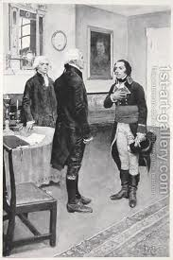
Jeffersonian party mad, even though TJ gets it
French send Genet
Tries to get US profiteers into war
Didn’t think Neutrality act reflected US true feelings
Tried to bypass GW
GW demanded w/drawl

Slide 21
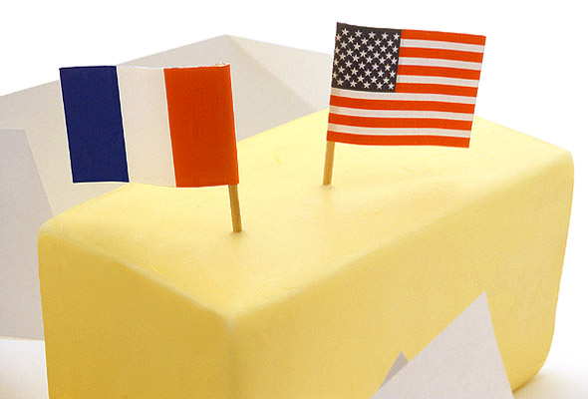
America and France benefitted from neutrality
If we were in war, we would have been blockaded, and no goods to France in W. Indies

Slide 22
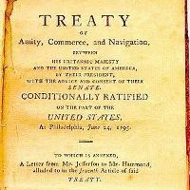
Embroilments with Britain
Needed to ease tension with Brit
Brit had been harassing frontier
Stirred up natives
We were losing battles against Natives with British support
Until in 1794 Miami’s loss at Fallen Timbers
were not sheltered by Brits, signed Treaty of Greenville
Gave up land in NW
Besides Native issues:
Brits Took our ships
Impressed our men

Slide 23
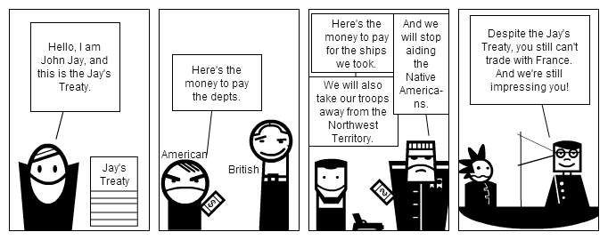
Jay’s Treaty/Farewell
Feds not want to go to war
We were in business with Brits
TJ wants embargo on Brit
Jay sent, TJ feared Jay, but Hamilton gave Brits our secret, Jay could not stand up to Brits

Slide 24
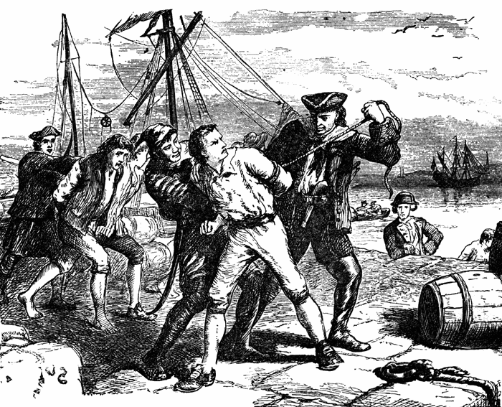
Provisions
Brit promised to remove fort
Would pay for damage from lost ship
Did not say anything about future impressments
US had to pay debts (many from S)
South felt betrayed N got paid, but they did not
S would be taxed to pay debt, but not get the money
War was averted
Senate barely approved

Slide 25
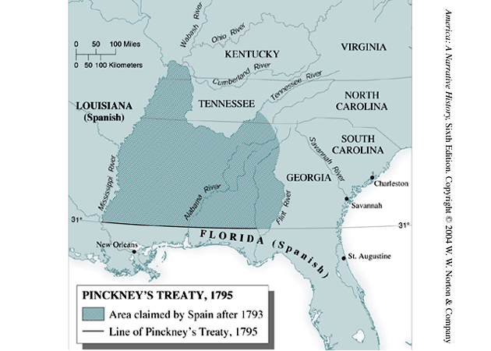
Pinckney 1795 (still part of Treaty/Farwell)
Byproduct of Jay’s treaty
Did want us being best buddies with Brits
Normalized relations with Spain
Free navigation of Miss
Right of Deposit at NO
Gave over large area of FLA
31st pll border

Slide 26
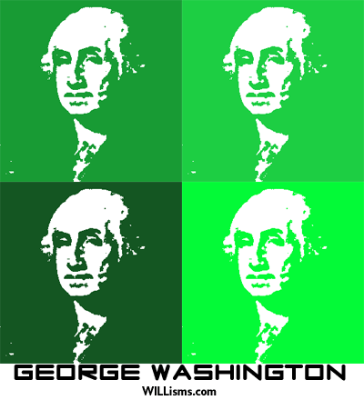
GW farewell
2nd term: Unanimous again
Federalist
Did not accept 3rd term
Tired and ready to go home
Farewell address
2/3 domestic
Warned against foreign alliances (for too long)
Isolationism for next 100 years
GW kept us out of wars

Slide 27
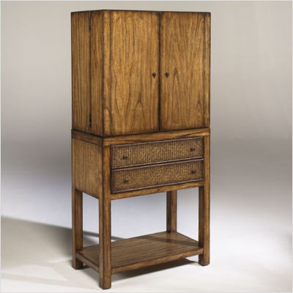
GW precedents
Cabinet
Relying on
Picking
Two term
Selecting Chief Justice outside of SC

Slide 28
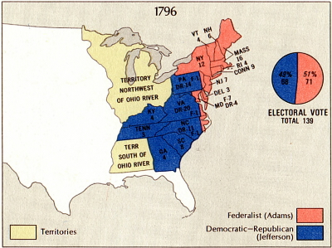
Adams becomes President
John Adams Federalist
TJ : Repub
Some mudslinging
Separate taverns!
Adams wins
TJ VP
Had to fill GW’s shoes
JA Hated by Hamilton (Same party!)

Slide 29
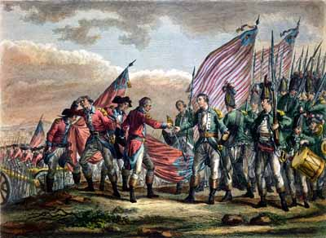
War with France
First issue:
French had condemned Jay treaty
French warships seize 300 ships
Threatened our envoy

Slide 30
Adams sends new envoys
Met by x, y, z
US refuse to pay bribe
When Marshall came home he was a hero for saying no
War fever
https://www.facebook.com/MrBettsClass/posts/948418795199800

Slide 31
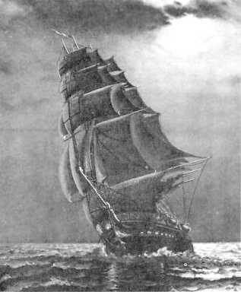
Unofficial fighting
Naval Dpt created
Only had a 3 ship navy
Marines established
Army raised
Suspended trade with France
2.5 years of undeclared fighting
Mostly in WIndies
Privateers and Navy
Were we going to war?

Slide 32
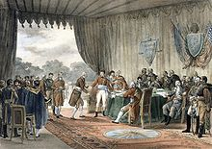
Adams puts Patriotism…
France wants Peace
Did not want another enemy
Adams shocked Feds by sending new Foreign minister
AH and Feds mad
TJ and Jeffs happy
Convention of 1800
negotiated with Napoleon
End Franco-American
US pay some damage
Major war missed
Louis purchase door opened
Adams felt best achievement

Slide 33
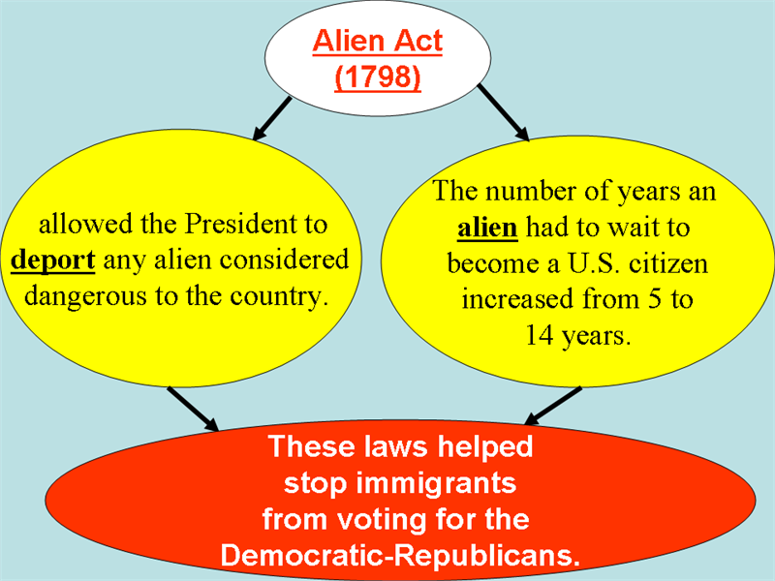
Federalist Witch Hunt
Feds pass laws to limit Jeffs
Alien Acts
Most immigrants siding with Jeffs
Feds going to raise citz to 14 yrs
Pres. Deport if needed
Get rid of problems (Genet)
Get rid of Brits
Never enforced, but many left

Slide 34
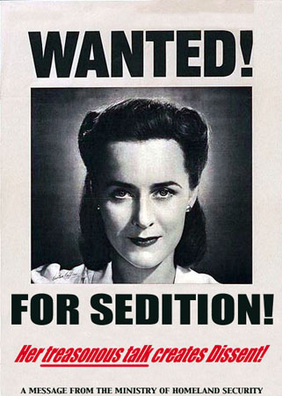
Sedition
Cannot impede govt. or accuse agents falsely
Vio of 1st
10 jeff editors brought to trial and convicted
Expired in 1801 on Adams leaving
Could not be used against them
Popular support, anti French
Feds win big in off year Congress elections

Slide 35
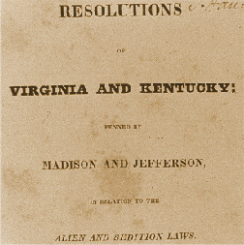
Vg and KY Reso
Jefferson and Madison write
Secret
States could nullify
Compact Theory
From Locke
States could decide whether constitutional
No states passed VG or KY so went away
Feds said job of SC to decide constitutionality not states

Slide 36
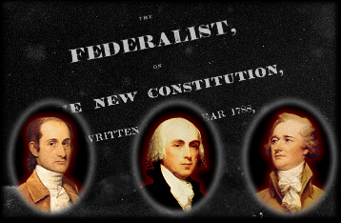
Federalist Legacy
Hamilton’s Financial plan
GW’s precedents
No war
No anarchy
Two party system
Westward expansion
BE FAT

Slide 37
