Slide 1
Chapter 37

Slide 2
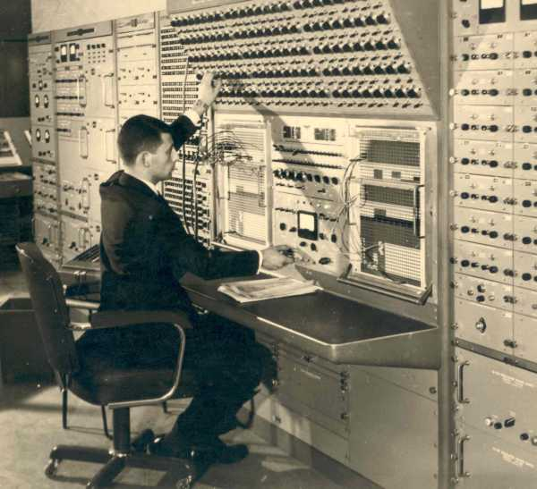
Affluence and Anxieties
Prosperity
Driven by science and technology
Computers change the landscape
Ike connects the economy to defense

Slide 3
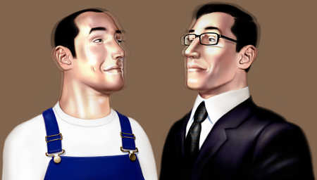
White collar replacing blue collar
Union membership started a decline

Slide 4
Cult of Domesticity resurfaced, but revolution was a coming!
Betty Friedan, The Feminine Mystique, begins to challenge the system

Slide 5
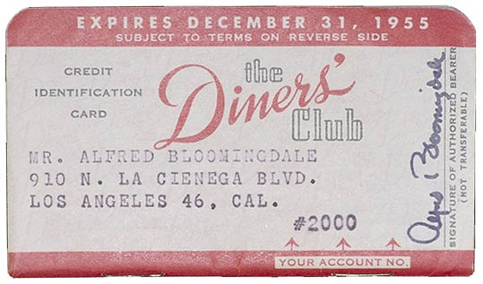
Consumer Culture
First credit card 1950
First McDonalds 54
Disneyland 55
TV
Advertising
Rock and Roll
Paperbacks
Playboy
Was this type of society good or bad?
https://www.youtube.com/watch?v=VBIxg3XiBaw

Slide 6
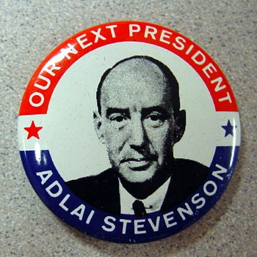
Advent of Eisenhower
Truman was very unpopular (23% approval rating).
Korea
China
McCarthyism
Civil Rights
Truman does not seek reelection.
Facing issues because of MacArthur
Inflation
Democrats nominate Adlai Stevenson.

Slide 7
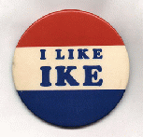
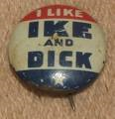
4. Republicans nominated Dwight D. Eisenhower in 1952.
5. Ike wins despite the problems brought on by Richard Nixon.
Nixon was accused of illegally taking money form supporters
Went on TV to defend himself. (4:46 min.)
Checkers
Shows power of TV

Slide 8
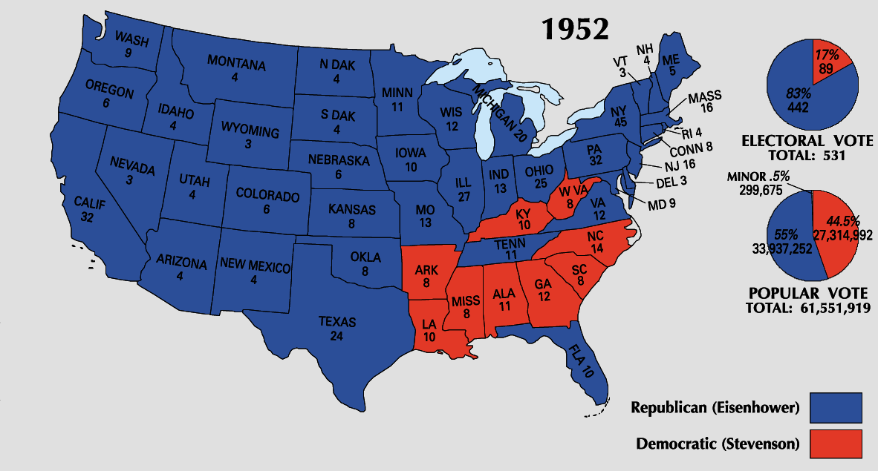

Slide 9
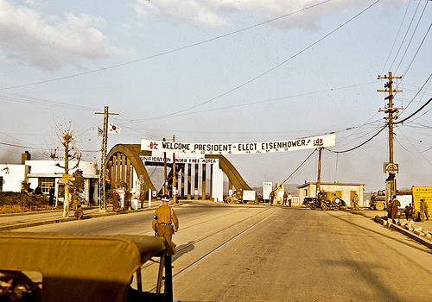
Ike went to Korea
Repubs take control of Congress
Ike makes good on promise:
Armistice in Korea
Ike threatened to use Atomic Weapons
Korea still divided to this day

Slide 10
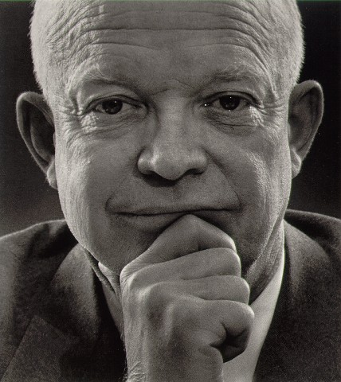
Ikes Goals
Restore tranquility
No major social changes
Balanced budget
Dismantle some New Deal
Try to keep military spending in check

Slide 11
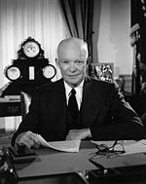
Ike had a number of domestic successes during his time:
Raised the minimum wage.
Extended Social Security.
Supported public housing.
Pushed for the creation of an interstate highway system.
Created the Departments of Health, Education and Welfare.
In 1954, SC ruled in Brown v. Board of Education of Topeka, Kansas that public school needed to end racial segregation

Slide 12
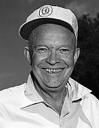
Viewed as fair and sincere
Was able to ease tensions and make people feel good
Liked to delegate
Faced some issues

Slide 13
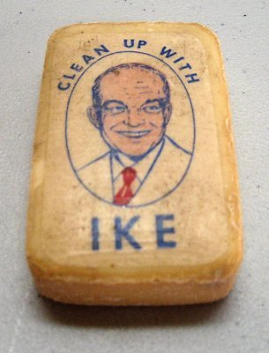
America wanted peace
Tired of depression and war
Ike could bring people together

Slide 14
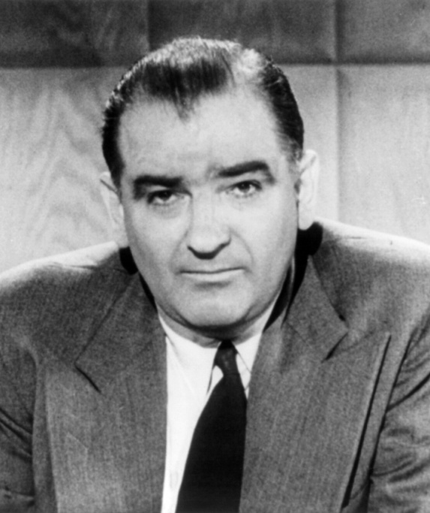
Ike’s Issues
Said Sec. of State Acheson had 205 people working for him who were communist
Then he said really only 57
His colleagues encouraged him
Publicity stunt
Accused Marshall of being involved, gone too far
People feared him, Ike did not do too much
After Korea some concern dropped
He lost his seat and died an alcoholic
McCarthy

Slide 15
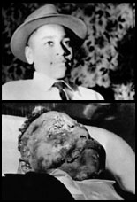
Desegragating
1950: 15 million af/am in US
2/3 live in S
Jim Crow ruled
Segregated schools and cities
20% registered to vote
Vigilante justice was common
1955 Emmet Till
https://www.youtube.com/watch?v=FqW4WkPxJ5Y
Times had to change

Slide 16
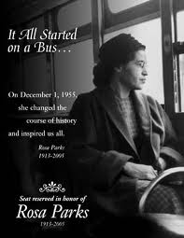
War made change possible
1944 white primary unconstitutional
1950 Marshall gets gov. to say that separate professional schools not good
1955 Rosa Parks

Slide 17
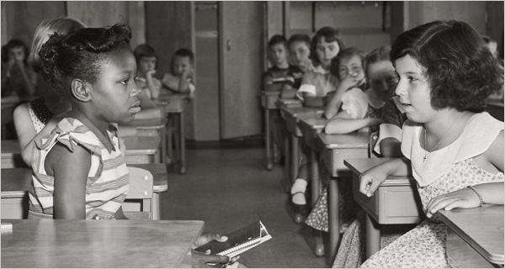
Seeds of Revolution TRUMAN VS IKE
1946 Truman starts change: Commissioned a report on civil rights
1948 integrate military and fed
Ike did not start off stellar
SC Chief Justice Warren was ready
1954 Brown overturns Plessy/1956 Brown II

Slide 18
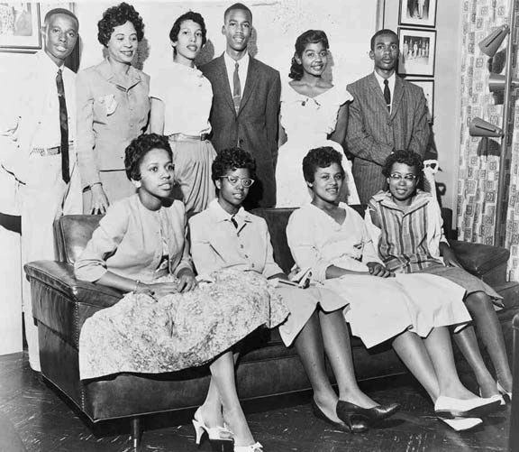
Little Rock
Ike kind of quiet at first on integration
More of a gradualist
Faubus in 57 changes that
Central High in Little Rock
Brought in army to make sure students were admitted and safe

Slide 19
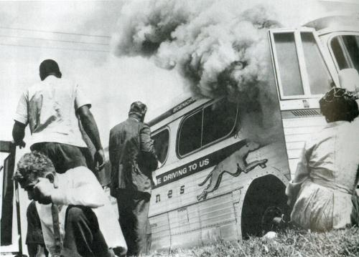
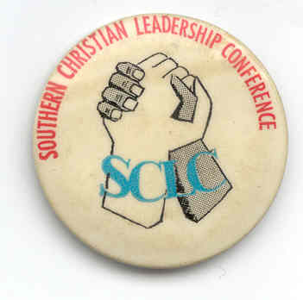
Groups started to form
CORE (1940s)
SNCC SCLC
1960s sit ins start

Slide 20
Ike at home
Dynamic Conservatism
Liberal in human issues, and conservative in economics
Cautious to stop Creeping Socialism
Cut back on some new deals, let gov. control of dams go

Slide 21
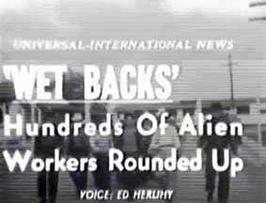
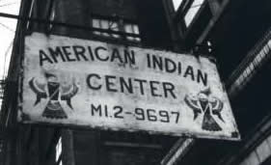
Rounded up Mexican Braceros (Operation Wetback 1954)
Termination act: no more tribal recognition

Slide 22
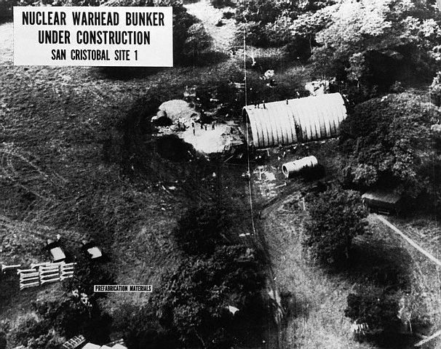
New Look at Foreign policy
Massive Retaliation
DULLES
Didn’t always help: 1956 Hungary
Military costs sore
Military Industrial Complex

Slide 23
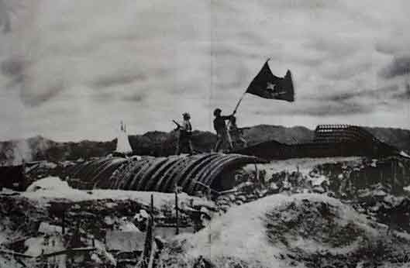
Vietnam
Asia beginning to erupt
US financing war between Ho and France
Dienbienphu (1954)
Geneva conference
Minh vs. Diem
Elections were sup. To be held, but were not
SEATO

Slide 24
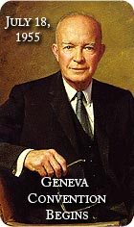
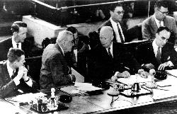
False Lull in Europe
US helped France to get Germany rearmed
W Germ in Nato 1955
Warsaw pact
Ike and Russia trying to hammer out peace
1955 Soviets let Austria go
US Russia meet in 55 Spirit of Geneva
Khrushchev in charge now

Slide 25
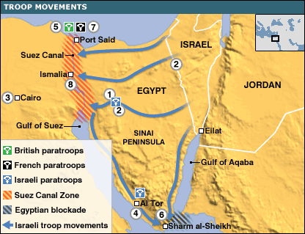
Cold War Crisis in Europe and Middle East
1953 Shah installed
Suez Crisis in Egypt
Nasser wants funds for dam
US and Brits offer help
He gets help from Russia too
Dulles withdrew dam offer
Nasser nationalized Suez hurt France, Eng, IS

Slide 26
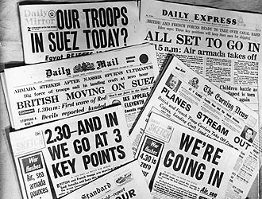
Oil in jep
IS, Eng, France attack in 56
They fear loss of oil and Russia attack
Dulles wants to keep us out
Europe thought we would keep them supplied with oil
Ike said “let them boil in their own oil.”
Last time we had enough oil to make threats
1957 Eisenhower Doctrine: US aid to Middle East
OPEC formed and can wield power by cutting off oil

Slide 27
https://www.youtube.com/watch?v=ss5Vh1od76I

Slide 28
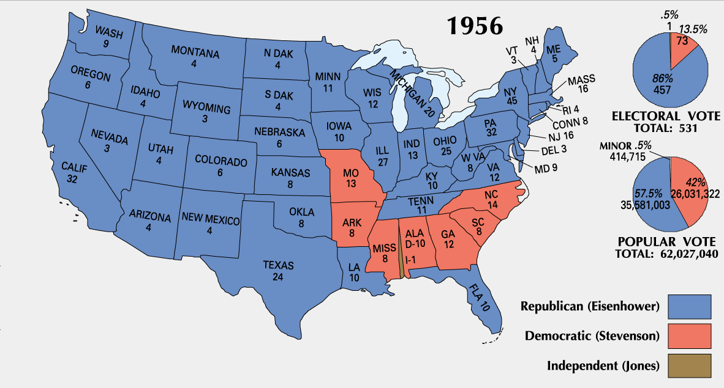
1956 election
Ike had been sick and a heart attack, but still liked in 56
Stevenson ran against
Criticized Ike for not doing much, health and questionable VP
People liked Ike

Slide 29
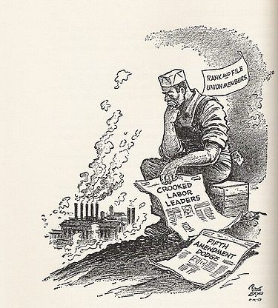
Ike seemed to leave start of second term to Dulles and Adams,
but Adams in trouble for taking money
and Dulles died
Ike back in charge

Slide 30
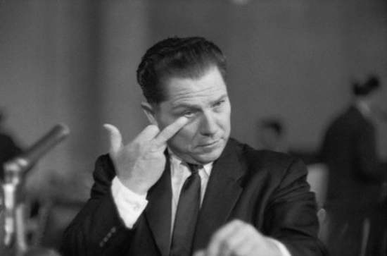
Round 2
Had to deal with labor
Looked into embezzlement by leaders
Landrum Griffin Act: punish leaders

Slide 31
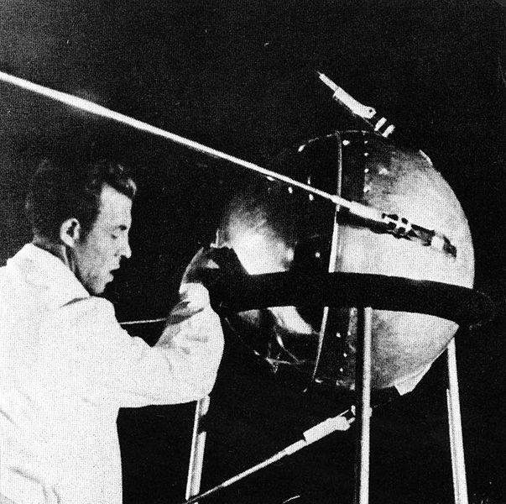
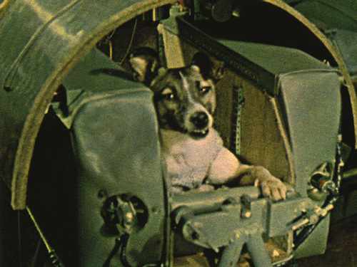
Space Race
1957 Sputnik
Sputnik II dog
US confidence shattered
Military fears
Blames on Truman
Missile gap?
1958 National Defense and Education Act: NDEA 887 million in loans for ed

Slide 32
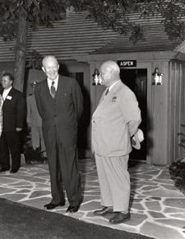
Continuing Cold War
1958 nuclear test bans starting
US aided Lebanon vs. Egypt and Russia
K gives alliance 6 months to leave Berlin
1959 summit
Camp David
Paris conference scheduled 1960
Francis Gary Powers shot down hurt good feelings

Slide 33
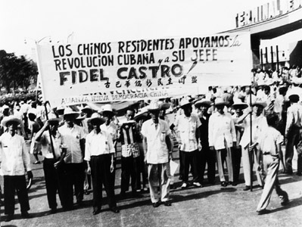
Cuba?
1958 Nixon goes to SA, but is stoned and had things thrown at him
Felt that they had not gotten any money
1954 us led coup in Guatemala
Batista in Cuba our friend for business
1959 Castro

Slide 34
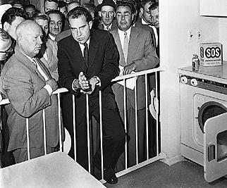
Kennedy and Nixon
Why was Nixon considered best candidate?
Kitchen Debate
Expert in foreign policy
JFKS problems
Catholic and rich

Slide 35
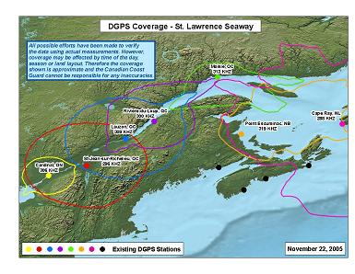
Fading away
Ike leaves as popular as when he entered
Vetoed 169 times only overturned 2x
Not a cripple
Avoided war, increased some new deal, did not handle civil rights much
St. Lawrence Seaway opened to trade and 50 states

Slide 36
Life and Mind of Postwar America

