Slide 1
Chapter 23
The Furnace of War

Slide 2
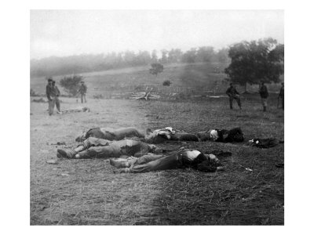
90 day war?
Lincoln’s original call was for 90 days
75000 militiamen
Was not going to mess with slavery where it existed
Just wanted to get country back together

Slide 3
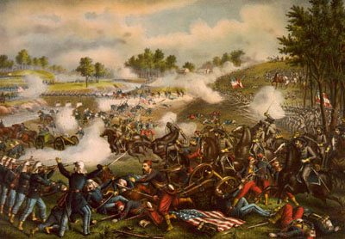
Lincoln planned for small engagement first at Bull Run (Manassas)
Close to Richmond could end the war
July 21 battle
South held firm like Stonewall
Union troops flee
Psychological and political consequences
N realizes this is not going to be easy

Slide 4
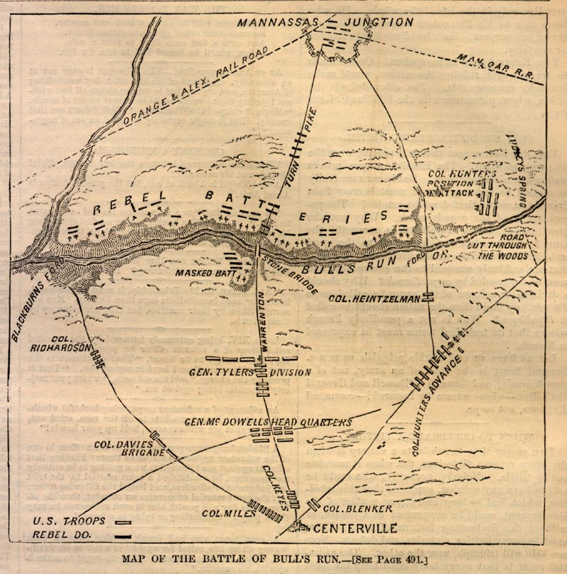

Slide 5
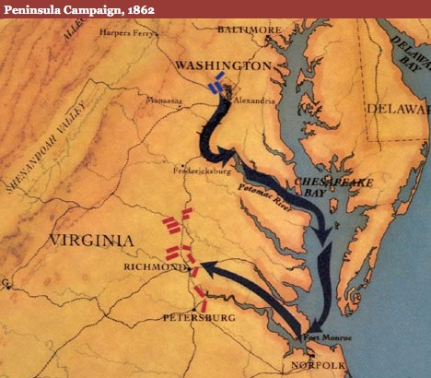
McClellan and Peninsula
Young Napoleon
Good organized, but not ready to commit forces
Gets bad intelligence from Pinkertons
Practices, but never attacks
Tardy Mac

Slide 6
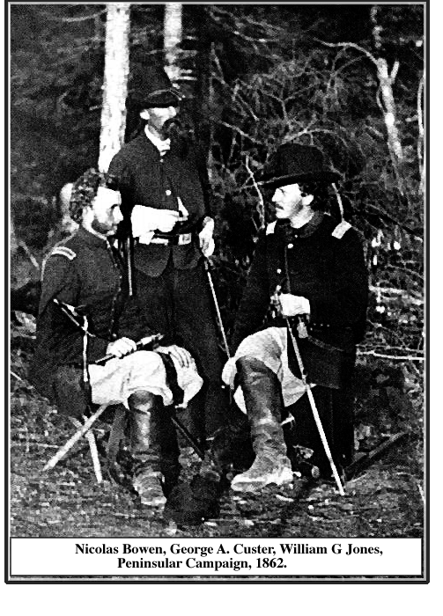

Slide 7
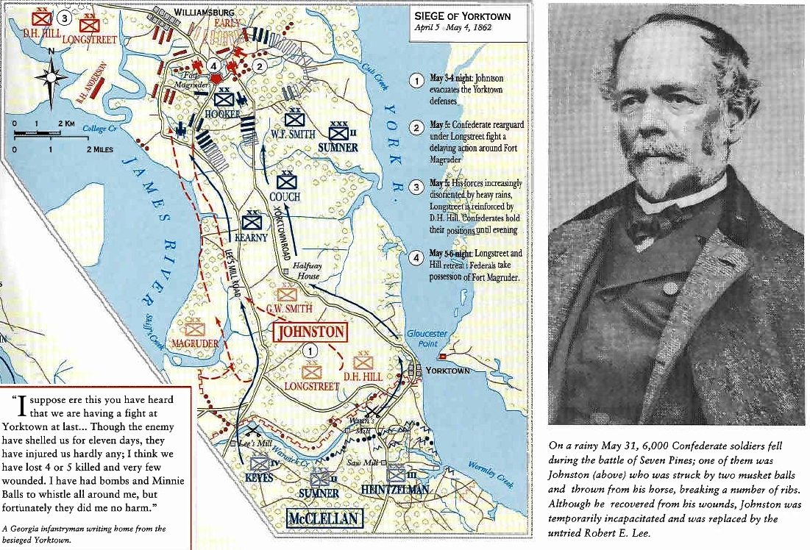
Finally attacks Richmond
Starts from water (Pennisula Campaign)

Slide 8
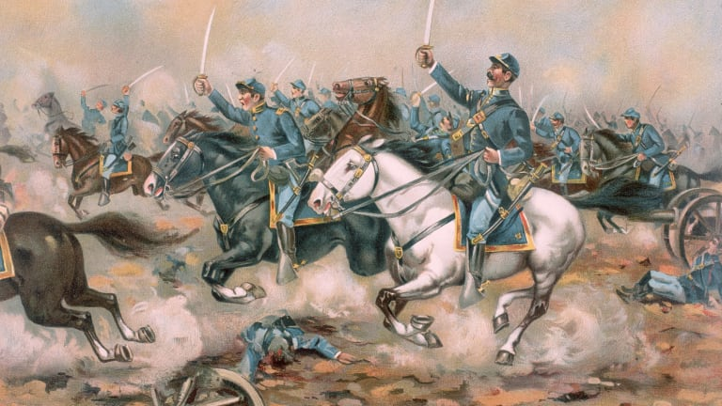
Took Yorktown, but slow. Afraid of wooden cannons
Abe loses patience, takes some men to chase Stonewall

Slide 9
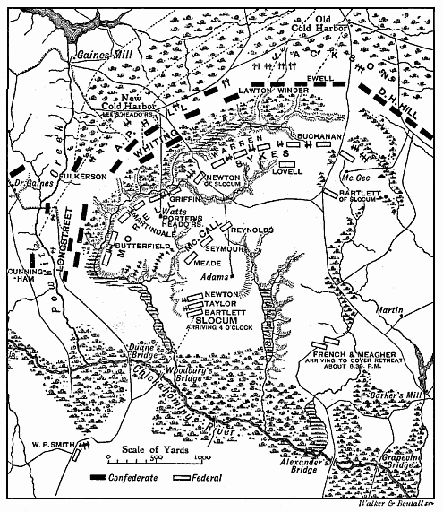
Lee counters with Seven Days Battle 1862
Union gives up, Mac fired
Had we won there, slavery would have stayed

Slide 10
Total war begins
  1. blockade
  2. liberate
  3. cut confed in half by taking Miss
  4. Chop up south
  5. Take Capital
  6. Grind down

Slide 11
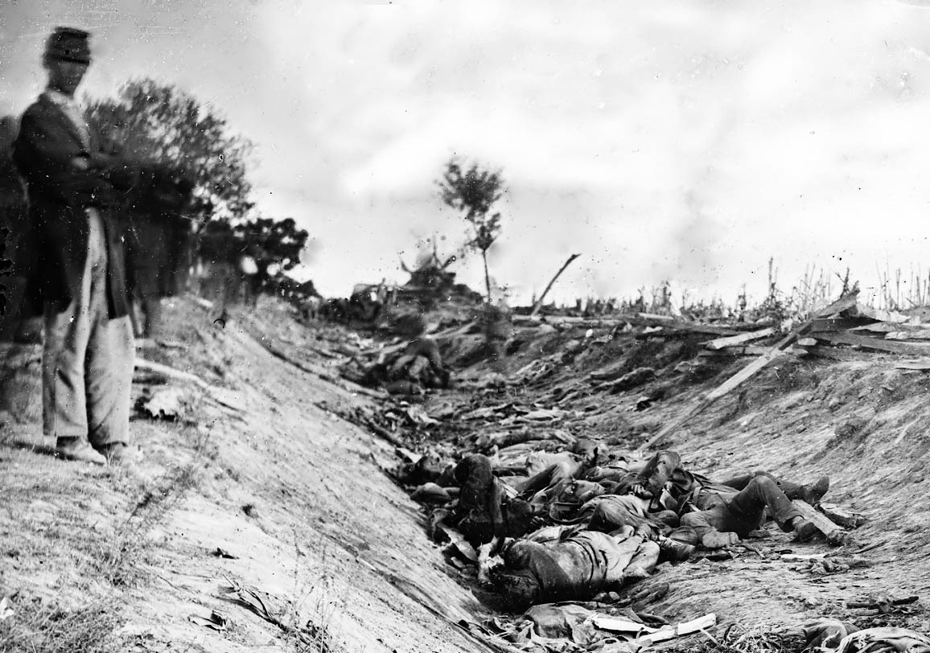
On to Antietam
Aug 1862
Second Battle of Bull Run
Pope defeated by Lee
Lee goes to Maryland thought they would join, but no go
Antietam next battle
Mac is back
  Found battle plans
  Worst day of battle 23000 in 12 hrs
  Mac removed for not chasing S
  Last major day for S
  Turning point for Europe
  Could now declare war on slavery

Slide 12
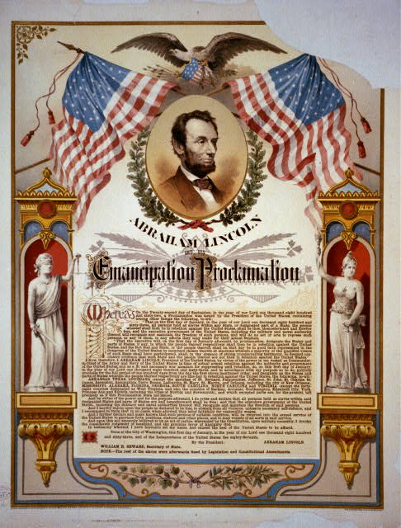
Emancipation
1863
Was waiting for victory
Only freed slaves in S
Up till 65 going to reimburse owners
Public reaction mixed: Some said we came to help the union, not the slaves
Some problems with fighting a war against slavery instead of for Union

Slide 13
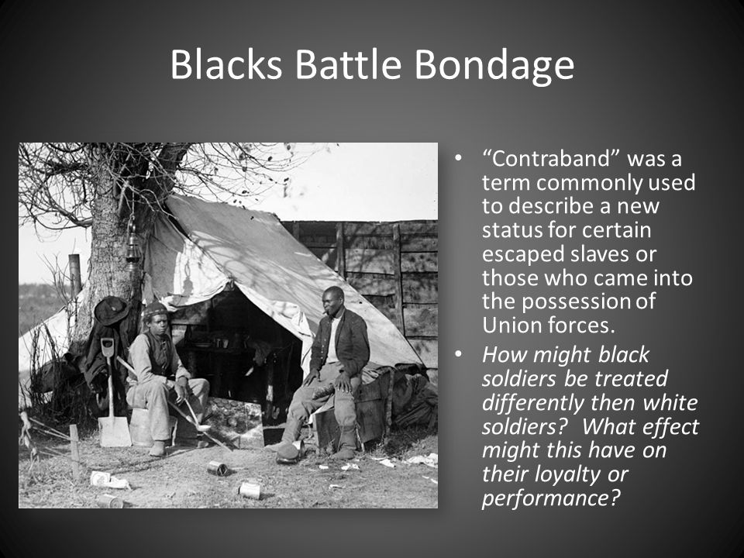
Blacks Battle Bondage
Lincoln wanted to enlist Af/Am
Army originally refused service
10% of total N service
S put many to death if captured (Fort Pillow)
Many African Americans in S acted as spies

Slide 14
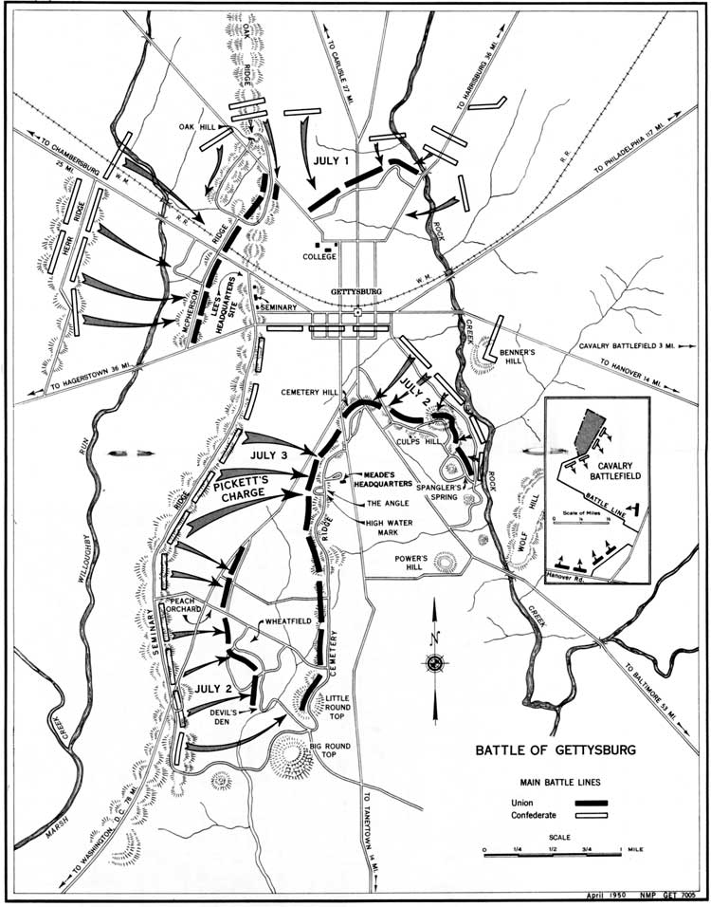
Lee’s Last Lunge at Gettysburg
Burnside put in charge after Antietam
  Lost at Fredericksburg
Hooker replaces Burnside
  Lost at Chancellorsville
Stonewall killed
Lee heads to Gettysburg, and from there DC?
Meade new gen. gets best ground
1863 Gettysburg address

Slide 15
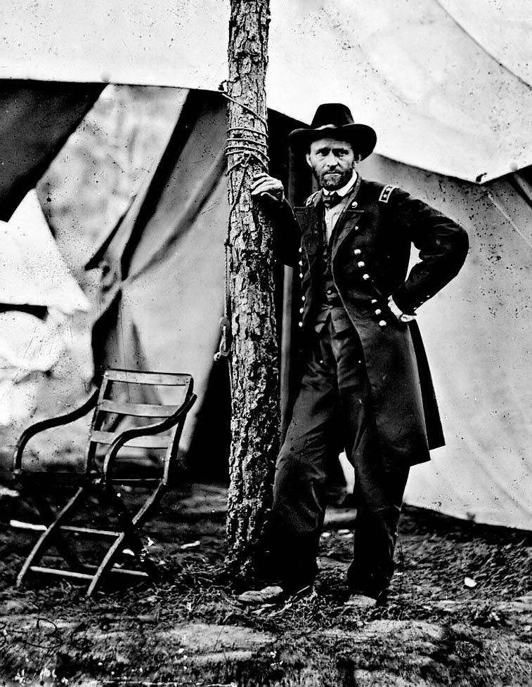
War in the West
Grant
A general who fought
Failure in life till war
Sloppy and drunk

Slide 16
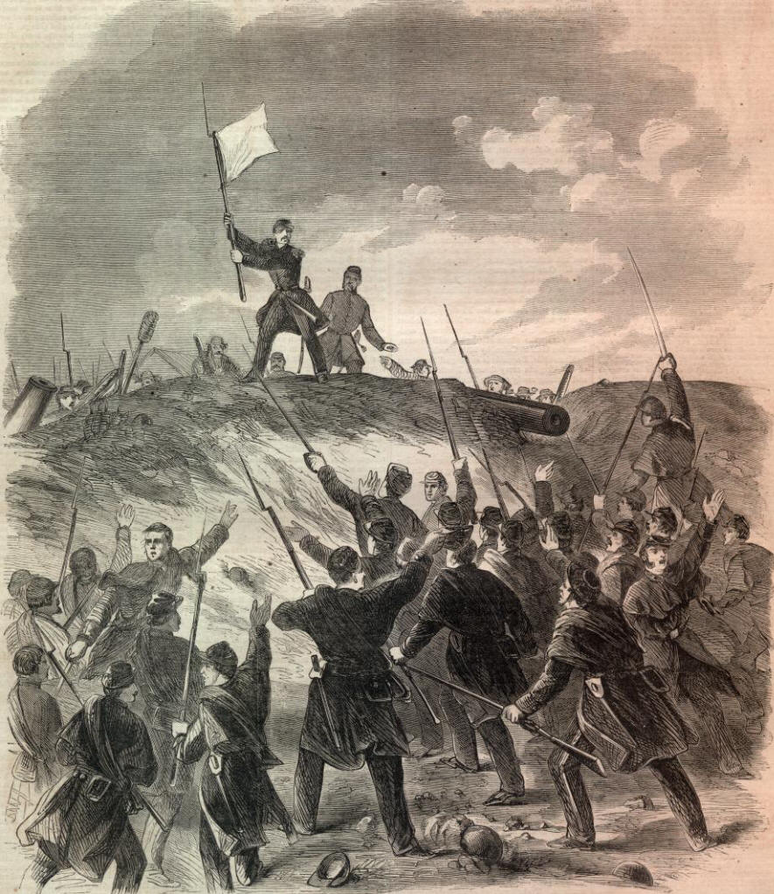
Won in Tenn.
captured Donelson and Henry
“Unconditional Surrender”
  Lost at Shiloh
AL did not remove him

Slide 17
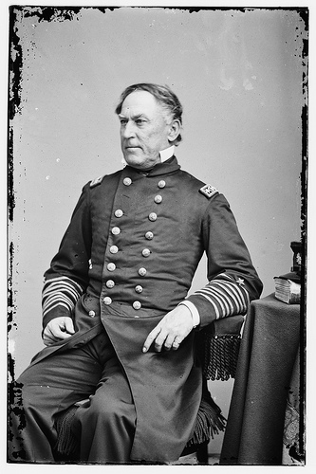
Union and Navy under Farragut worked together by taking N O, cut off S, no supplies to far west
Grant takes Vicksburg, Port Hudson, now N had Miss
By 1863 South had lost, but would not give up

Slide 18
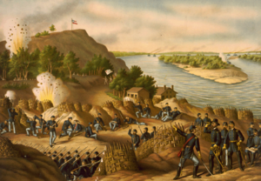

Slide 19
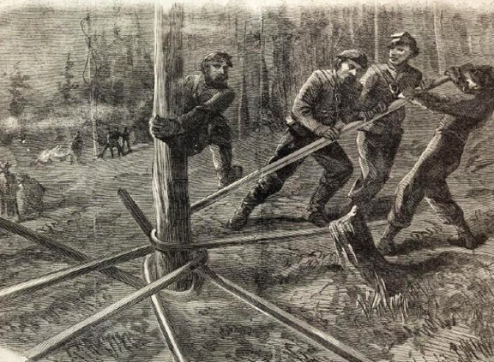
Sherman scorches Georgia
Grant moves off to Chickamauga and Chattanooga
Sherman put in charge of taking Georgia

Slide 20
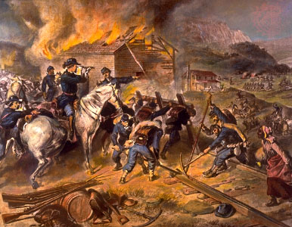
Total War, make it so bad it would never happen again
  Sherman Bowties
From Georgia to SC

Slide 21
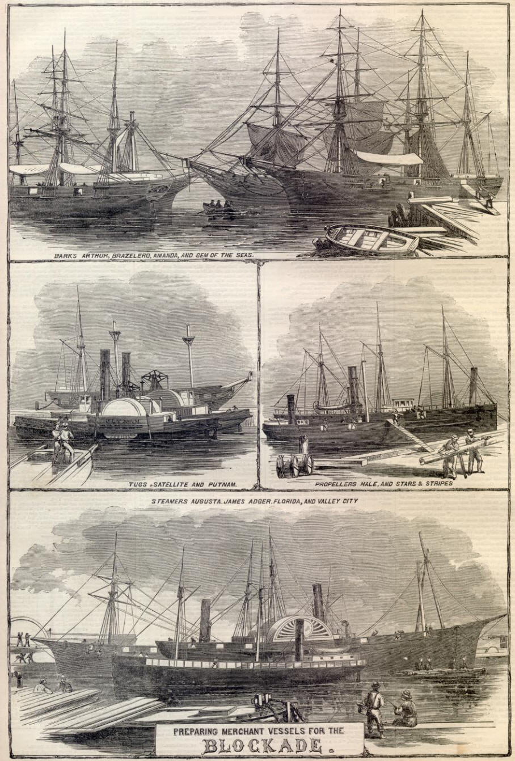
Naval Battles
Blockade: leaky
  3500 mi of coast
  Britain could not condemn because t hey used
  Blockade running common
N seized British boats, Continuous voyage

Slide 22
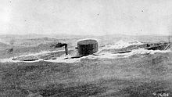
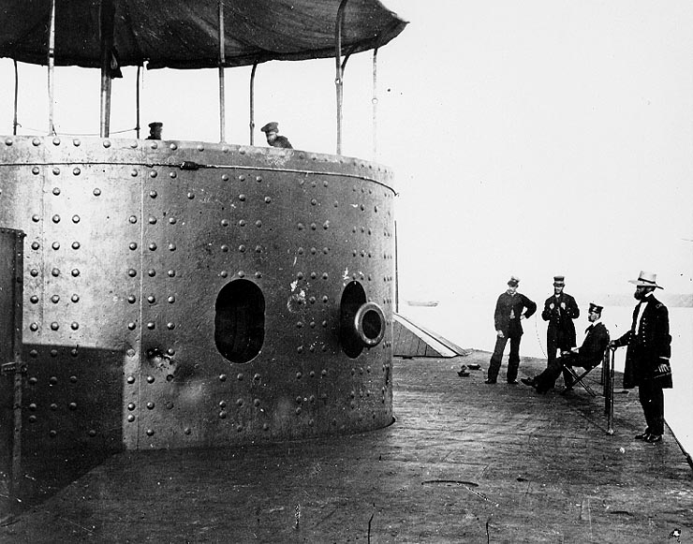
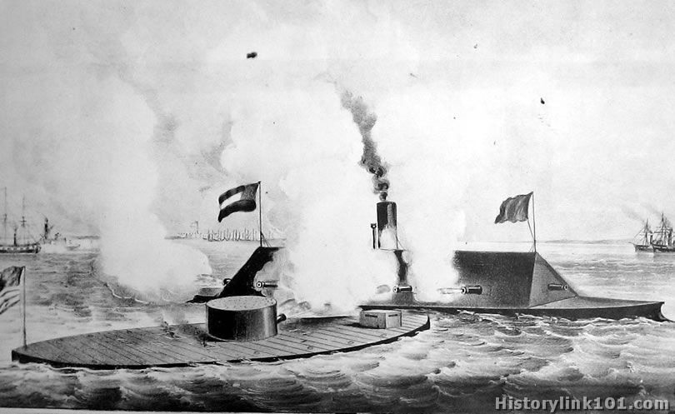
S made Merrimack, renamed VG fought Monitor
Farragut fights with army to help with win

Slide 23
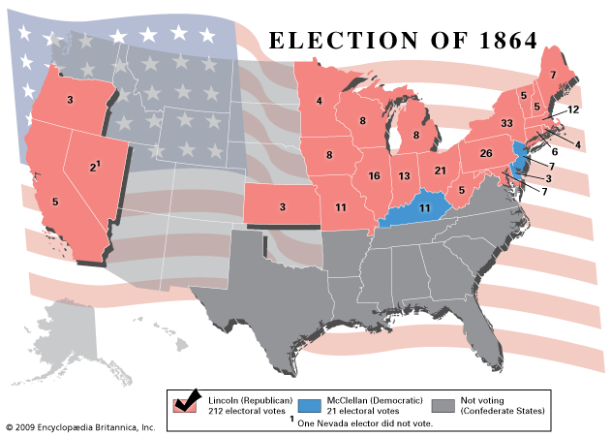
Politics of War
1864 Election year
  Lincoln had critics
  Sec of Tres. Chase the loudest
  Some of congress not happy with Lincoln’s use of power

Slide 24
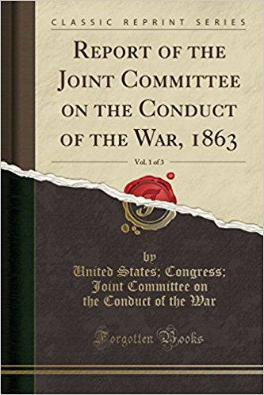
Congressional Committee on the conduct of war
    Radical Republicans
    Upset at Presidential power
    Wanted Emancipation

Slide 25
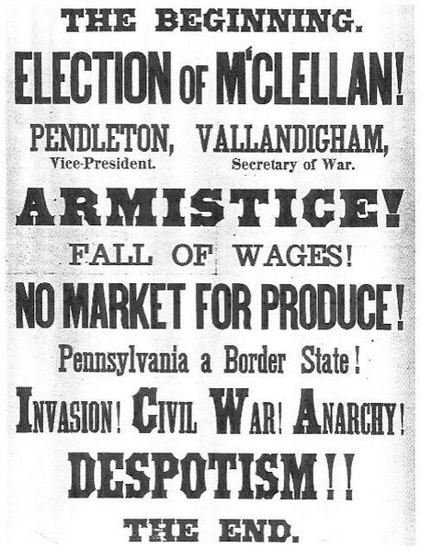
Democrats divided
  Douglas died and they split into war and peace Demos
  Copperheads (peace demos) obstructed war

Slide 26
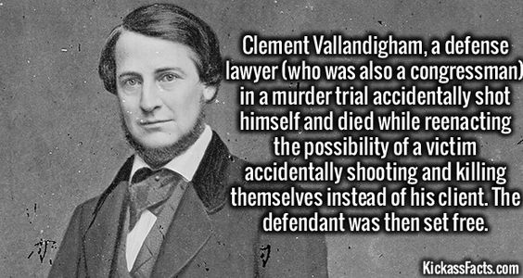
  Vallandigham: Demanded end to war supported S
  Arrested and tried in military court, shipped to south
  Escaped to Canada and ran for Gov. of Ohio

Slide 27
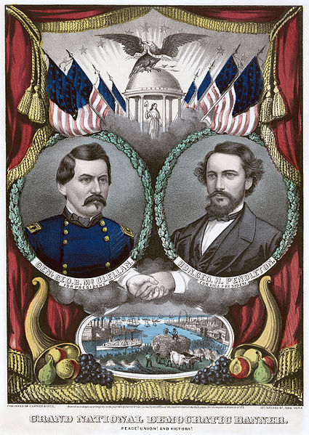
Election of 64
Lincoln Joined with War Demos, called Union party and brought in Johnson
Demos pick McClellan
  Ugly election
Northern victories saved Lincoln
Many soldiers sent home to vote

Slide 28
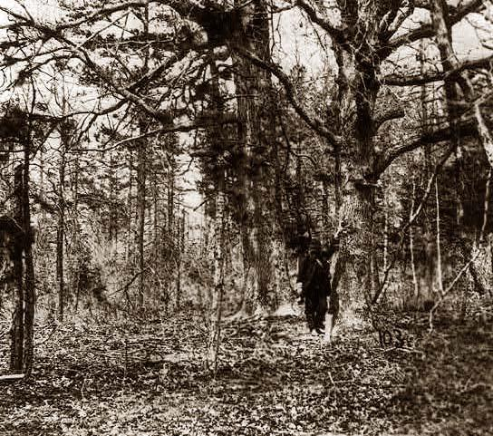
Grant Outlasts Lee
Grant given control of whole army and heads to Richmond
  Wilderness battles in VG.
    Horrible battles, attrition

Slide 29
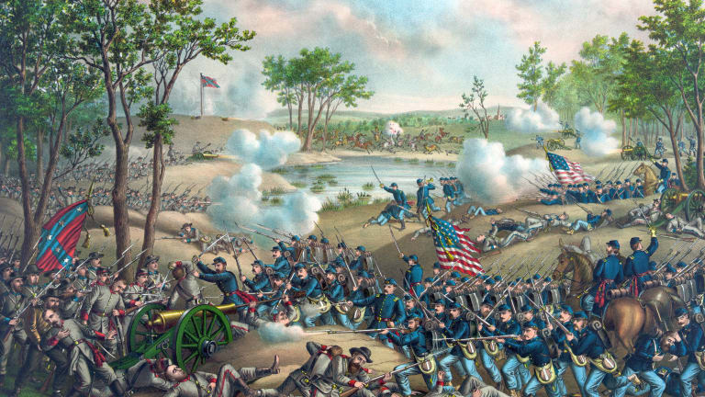
    Cold Harbor:
    Frontal Assault
    names and address on backs

Slide 30
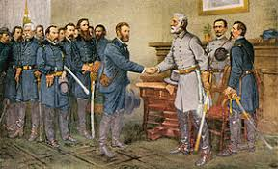
Lee actually was more blood and guts fighting
Lee dug in, and lost more men
Appomattox 1865 Grant and Lee sign papers

Slide 31
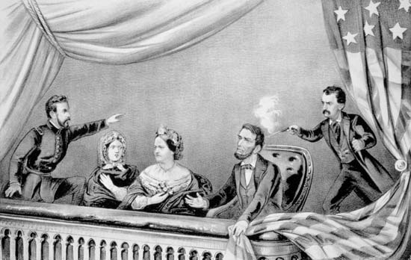
Martyrdom and Death
1865 assassination
  S cheered at first, but would wish he lived

Slide 32
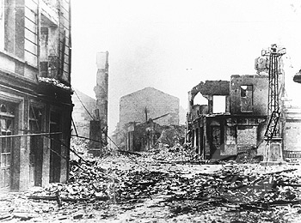
Aftermath
600,000 plus men died
15 billion in money
Spurred on Democracy in other countries
  English Reform bill: True Democracy
Beginning of a new time

