Slide 1
Chapter 16: World War Looms Section 1: Dictators Threaten World Peace

Slide 2
1
S E C T I O N
Dictators Threaten World Peace
ASSESSMENT
Why do you think Hitler found widespread support among the German people?
ANSWER
Germany was devastated by the effects of World War I. The nation suffered from severe economic depression. Hitler promoted the Nazi party as a way to restore national pride.

Slide 3
1
S E C T I O N
Dictators Threaten World Peace
ASSESSMENT
Identify the main ambitions of each dictator listed in the web diagram.
Stalin:
ANSWER
Hitler:
Create a model Communist state and transform the Soviet Union into a great industrial power
Unite the German “master race” into an empire destined to rule the world
Dictator’s Ambitions
Mussolini:
Franco:
Make Italy a great world power
Become Spain’s supreme military leader

Slide 4
World War Looms
TIME LINE
The United States
The World
1931 The Empire State Building opens in New York City.
1931 Japan conquers Manchuria, in northern China.
1932 Franklin Delano Roosevelt is elected president.
1933 Prohibition ends.
1933 Adolf Hitler is appointed German chancellor and sets up Dachau concentration camp.
1934 Stalin begins great purge in USSR. Chinese communists flee in the Long March.
1936 Jesse Owens wins four gold medals at Olympics in Berlin, Germany. Roosevelt is reelected.
1936 Ethiopia’s Haile Selassie asks League of Nations for help against Italian invasion. General Francisco Franco leads a fascist rebellion in Spain.
1937 Amelia Earhart mysteriously disappears attempting solo round-the-world flight.

Slide 5
World War Looms
TIME LINE
The United States
The World
1938 Orson Welles broadcasts The War of the Worlds, a fictional alien invasion.
1938 Kristallnacht—Nazis riot, destroying Jewish neighborhoods.
1939 Germany invades Poland. Britain and France declare war.
1940 Roosevelt is elected to a third term.
1941 United States enters World War II.
1941 Japan bombs Pearl Harbor.

Slide 6
I. Rise of Fascism and Nationalism in Europe & Asia
A. Why?
1. Treaty of Versailles failed to provide a “just and secure peace” as promised.
2. The Allies installed new democratic governments in Europe after World War I including the Weimar Republic in Germany.

Slide 7
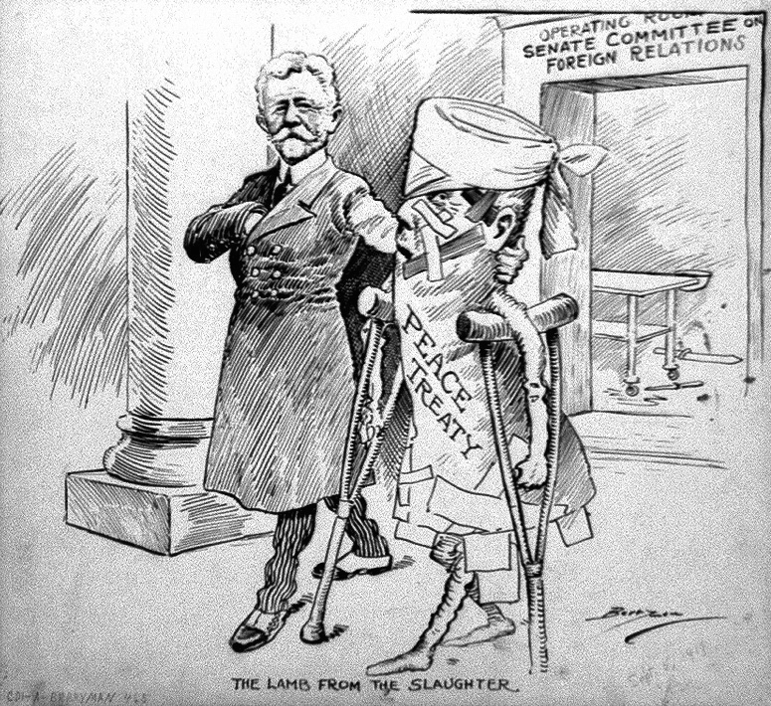
The Versailles Treaty (above on crutches) took a beating in the U.S. and abroad

Slide 8
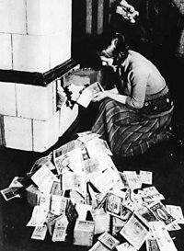
A German woman is seen here in 1923 feeding bundles of money into the furnace. . .why?

Slide 9
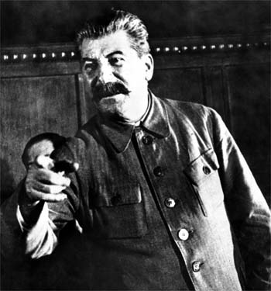
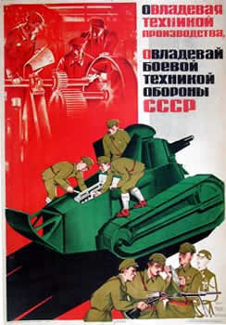
B. Soviet Union and Joseph Stalin:
His goals included both agricultural and industrial growth
How? Abolished all privately owned farms & industries

Slide 10
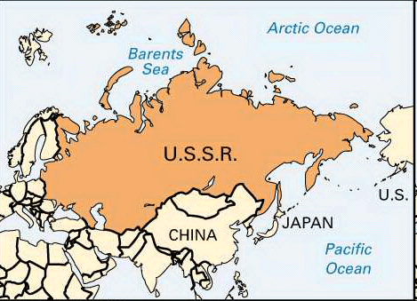

Slide 11
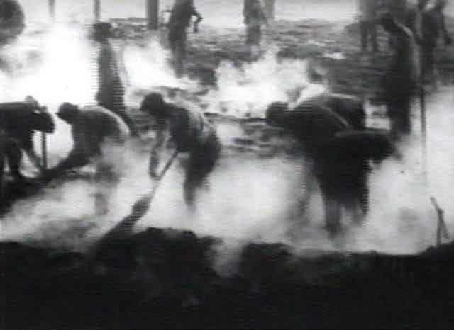
3. In his desire to purge (eliminate) anyone who threatened his power, Stalin was responsible for the deaths of 8 – 13 million of his own Soviet citizens
Labor camp workers in Siberia -- Stalin sent millions of political prisoners to labor camps

Slide 12
4. In a totalitarian state the government suppresses (crushes) all opposition and has strict control over the citizens who have no civil rights
In totalitarian states citizens are expected to treat the dictator with adoration

Slide 13
C. Italy and Mussolini
1. Mussolini seized power, taking advantage of high unemployment, a bad economy and a middle-class fear of Communism

Slide 14
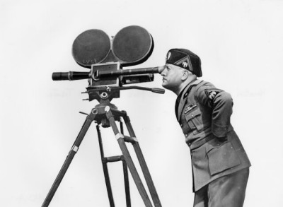
2. By 1921, Mussolini had established the Fascist Party -- Fascism stressed nationalism and militarism and placed the interest of the state above the interests of the individual

Slide 15
A Venn Diagram Communism vs. Fascism
Devotion to the state is most important or paramount.
Each class in society has a place and function.
Total control of the press.
Seeks an international revolution.
Has a socialist economy.
Ultra-nationalism: country and/or race.
The state must struggle to survive even if it means war.
Authoritarian leader knows all and is “worshipped”.
Does not follow a predefined ideology.
Appeals to the middleclass and industrialists.
No unions or strikes.
Use of propaganda to control the thoughts and actions of society.
Use of youth groups.
Use of ancient myth of racial superiority incorporated into society.
Use of mass rallies and parades to foster support.
Seeks a classless society.
Government controls all human activities.
No individual rights.
Wears uniforms usually of a certain color.
Glorifies the military and war.
Has a secret police.
Condemns socialism and supports private property.
Attempts to control religion.
Seeks to eliminate religion.
Has a special salute.
Views women as inferior despite its public rhetoric.
Its ideology is most important or paramount.
Defends private property
No private ownership of land or property.
Dictatorial one party rule.

Slide 16
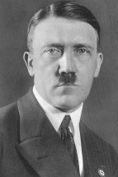
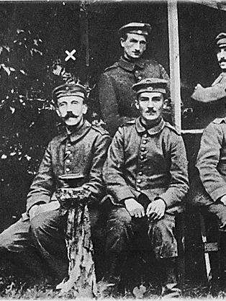
D. Germany and Hitler
1. At the end of WWI he was a jobless soldier drifting around Germany
2. In 1919, he joined a struggling group called the National Socialist German Workers’ Party (Nazis)
Hitler, far left, shown during WWI

Slide 17
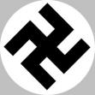
3. Hitler’s ability as a public speaker and organizer drew many followers
4. He quickly became the Nazi Party leader
5. Calling himself “Der Fuhrer” (the leader) he promised to return Germany to its old glory

Slide 18
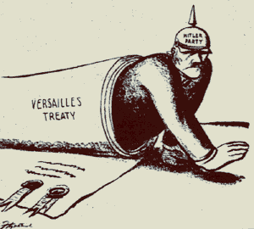
Hitler rose to power in part by criticizing the Versailles Treaty as unfair and humiliating to the proud German nation

Slide 19
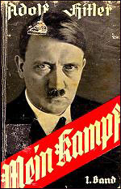
E. Hitler’s Beliefs
1. Hitler explained his beliefs in his book, Mein Kampf (My Struggle)
2. He wanted to unite all German-speaking people under one Empire
3. He wanted racial purity – “inferior” races such as Jews, Slavs and all non-whites were to form a work force for the “master race” – blond, blue-eyed “Aryans”
He alone, who owns the youth, gains the Future!
-- Adolf Hitler, speech at the Reichsparteitag, 1935

Slide 20
4. Another element of Hitler’s grand design was national expansion
-Hitler called it “Lebensraum” or living space
6. Hitler believed that for Germany to thrive it needed more land at the expense of her neighbors
Hitler posed an immediate threat to Czechoslovakia, Poland, Austria, France, Belgium and the Netherlands

Slide 21
7. By mid-1932, the Nazis had become the strongest political party in Germany
8. In January of 1933, Hitler was appointed Chancellor (Prime Minister)
9. Created a totalitarian government
Hitler was appointed chancellor by the aging President Hindenburg of the Weimar Republic

Slide 22
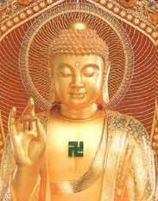
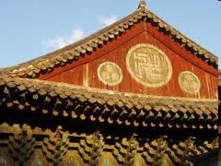

Slide 23
This poster announces a Nazi meeting in Munich in May 1920. Hitler is to speak on the topic "What do we want?" The text below the title reads: "Citizens! Do not believe that the Germany of misfortune and misery, the nation of corruption and usury, the land of Jewish corruption, can be saved by parties that claim to stand on a foundation of facts. Never!" Courtesy of Dr. Robert D. Brooks.

